Slide 1

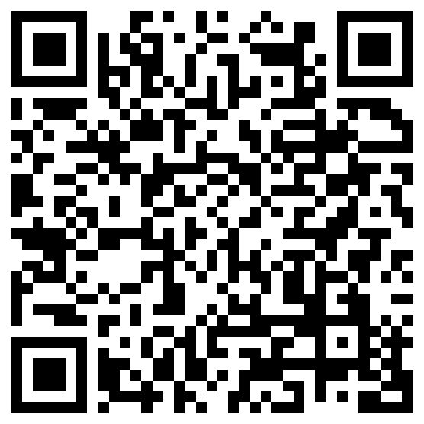
Identifying lexical semantic categories from noisy inference judgments
Aaron Steven White
University of Rochester
MGRG Seminar
University of Edinburgh
1 October 2024

Slide 2
Overarching question
In using a particular linguistic expression, what can we mean and what must we mean?

Slide 3
Bo no longer thinks that Jo is heading out to get groceries.
⇝
Cessation inference
Bo:
[to Jo] I thought you were heading out to get groceries.
Jo:
I remembered that I went a few days ago, but I’m now realizing I forgot to grab beer.
⇝
Veridicality inferences
Jo went to get groceries a few days before.
Jo did not grab beer.

Slide 4
Overarching question
In using a particular linguistic expression, what can we mean and what must we mean?
Observation
What we can mean in using an expression is constrained by lexical knowledge.

Slide 5
Bo no longer thinks that Jo is heading out to get groceries.
⇝
Cessation inference
Bo:
[to Jo] I thought you were heading out to get groceries.
Jo:
I remembered that I went a few days ago, but I’m now realizing I forgot to grab beer.
describes a mental event grounded in experience
⇝
Veridicality inferences
Jo went to get groceries a few days before.
Jo did not grab beer.

Slide 6
Overarching question
In using a particular linguistic expression, what can we mean and what must we mean?
Observation
What we can mean in using an expression is constrained by lexical knowledge.
in conjunction with structural knowledge

Slide 7
Bo no longer thinks that Jo is heading out to get groceries.
⇝
Cessation inference
Bo:
[to Jo] I thought you were heading out to get groceries.
Jo:
I remembered that I went a few days ago, but I’m now realizing I forgot to grab beer.
⇝
Veridicality inferences
Jo went to get groceries a few days before.
Jo did not grab beer.

Slide 8
Bo no longer thinks that Jo is heading out to get groceries.
⇝
Cessation inference
Bo:
[to Jo] I thought you were heading out to get groceries.
Jo:
I remembered that I went a few days ago, and I’m now realizing I forgot that I even grabbed beer already.
⇝
Veridicality inferences
Jo went to get groceries a few days before.
Jo did not grab beer.

Slide 9
Question
What knowledge undergirds what we must mean in using an utterance?

Slide 10
Concepts
Language
NP
forget
to VP
⇝
NP not VP

Slide 11
Question
What types of concepts does language “see”?

Slide 12
Concepts
Language
NP
forget
that S
⇝
S

Slide 13
Concepts
Language
NP
forget
that S
⇝
S

Slide 14
Question
What types of concepts does language “see”?
Prior Work
For some areas of the lexicon, we have a solid understanding what language “sees”.

Slide 15
Generalization #1 Barwise & Cooper 1981
Determiners are conservative: if D is a determiner then D expresses a relation R between sets A and B
s.t. R(A, B) iff R(A, A ∩ B).

Slide 16
Every greyhound is happy.
Every greyhound is a happy greyhound.
Some greyhound is happy.
Some greyhound is a happy greyhound.
Most greyhounds are happy.
Most greyhounds are happy greyhounds.

Slide 17
Generalization #1 Barwise & Cooper 1981
Determiners are conservative: if D is a determiner then D expresses a relation R between sets A and B
s.t. R(A, B) iff R(A, A ∩ B).
Language only “sees” relational concepts of this form.

Slide 18
Generalization #2 Gärdenfors 2000, Jäger 2010
Color terms express convex regions in color space.

Slide 19
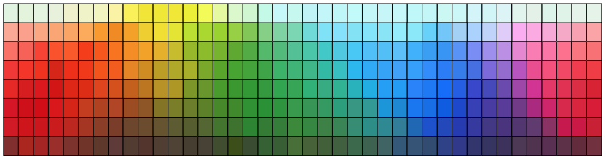
Language only “sees” convex color concepts.

Slide 20
Challenge
As we expand to larger and more open classes of words, generalizations tend to be harder to find.
Example
Even in well-studied areas of the lexicons of well-studied languages, there remains debate about generalizations.

Slide 21
Generalization #3 Levin and Rappaport Hovav 2006, Rappaport Hovav and Levin 2010
A verb may not encode (trigger necessary inferences about) both an action’s manner and its result.

Slide 22
 | Manner only | Result only
(Potential) change of state | hit, kick, pour, shake, shovel, slap, wipe, … | break, crack, fill, empty, melt, open, shatter, …
Directed motion | amble, crawl, hop, jog, limp, run, swim, walk, … | arrive, come, enter, exit, fall, go, rise, …

Slide 23
Putative Counterexamples
Cifuentes Ferez 2007, Goldberg 2010, Koontz-Garboden & Beavers 2010, Mateu & Acedo-Matellan 2011, Zlatev & Yangklang 2004
climb (manner: clamber, result: reach top)
cut (manner: contact with sharp edge, result: separation)

Slide 24
The climb involved the boy clambering.
The boy climbed the tree.
The climb resulted in the boy reaching the top of the tree.

Slide 25
Putative Counterexamples
Cifuentes Ferez 2007, Goldberg 2010, Koontz-Garboden & Beavers 2010, Mateu & Acedo-Matellan 2011, Zlatev & Yangklang 2004
climb (manner: (clamber) upward, result: reach top)
cut (manner: contact with sharp edge, result: separation)
Fillmore 1982
Jackendoff 1985
Guerssel et al. 1985, Levin (1993)
Possible Defense Rappaport Hovav and Levin 2011
There are two senses of each counterexample encoding only manner or only result.

Slide 26
The climb involved the boy clambering.
The boy climbed the tree.
The climb resulted in the boy reaching the top of the tree.
The climb involved the train clambering.
The train climbed the hill.
The climb resulted in the train reaching the top of the tree.

Slide 27
Question
When do we decide whether to save a generalization by positing new senses?
Criterion (often implicit)
Relative frequency of pattern of inference (e.g. manner only, result only, or both) across tokens and/or types.

Slide 28
The climb involved the boy clambering.
The boy climbed the tree.
The climb resulted in the boy reaching the top of the tree.
If we are already thinly slicing senses, what justifies the assumption that these aren’t also distinct senses?
The climb involved the train clambering.
The train climbed the hill.
The climb resulted in the train reaching the top of the tree.
Notes:
So for instance, the assumption implicit in a defense of manner-result complementarity that adduces these data is that tokenings of the form “climb” like the first aren’t sufficiently prevalent to support a distinct sense. But ultimately, we also want to ensure that we don’t observe a ton of other verbs that look like the first climb; otherwise, that distinct sense becomes more plausible, even if its tokenings relatively constrained.

Slide 29
Empirical Challenge
To determine a pattern’s relative frequency we often have to take large samples of lexical item types and/or tokens.
Methodological Challenge
We need a way of detecting when a pattern is the result of “summing over” senses v. a product of a single sense.

Slide 30
Empirical Approach
Scale standard experimental methods to annotate large samples for inference + acceptability judgments.
Synthesizes multiple kinds of data into single representation
Methodological Approach
Develop and deploy multiview clustering and factorization methods that explicitly represent polysemy and other sources of “noise” in inference and distribution patterns.
Patterns should incorporate both inference and distribution to ensure that resulting clusters plausibly captures semantic classes.

Slide 31
Case Study
Clause-embedding predicates’ inferential affordances and distributional profiles.

Slide 32
Bo:
[to Jo] I thought you were heading out to get groceries.
Jo:
I remembered that I went a few days ago, but I’m now realizing I forgot to grab beer.
⇝
Jo went to get groceries a few days before.
Jo believed that Jo went to get groceries a few days before.
Jo intended to grab beer.

Slide 33
Case Study
Clause-embedding predicates’ inferential affordances and distributional profiles.
Scientific Interest
These inferences appear to correlate with distribution, but we don’t have a full picture of how they coalesce into general patterns or how they correlate w/ distribution.

Slide 34
Part 1
Part 2
Measuring the distribution of clause-embedding predicates.
Measuring inferences triggered by clause-embedding predicates.
Part 4
Part 3
Develop and deploy a model for analyzing inferential patterns and their correlations with distribution.
Develop and deploy a model for inducing inferential patterns that correlate with distribution.

Slide 35
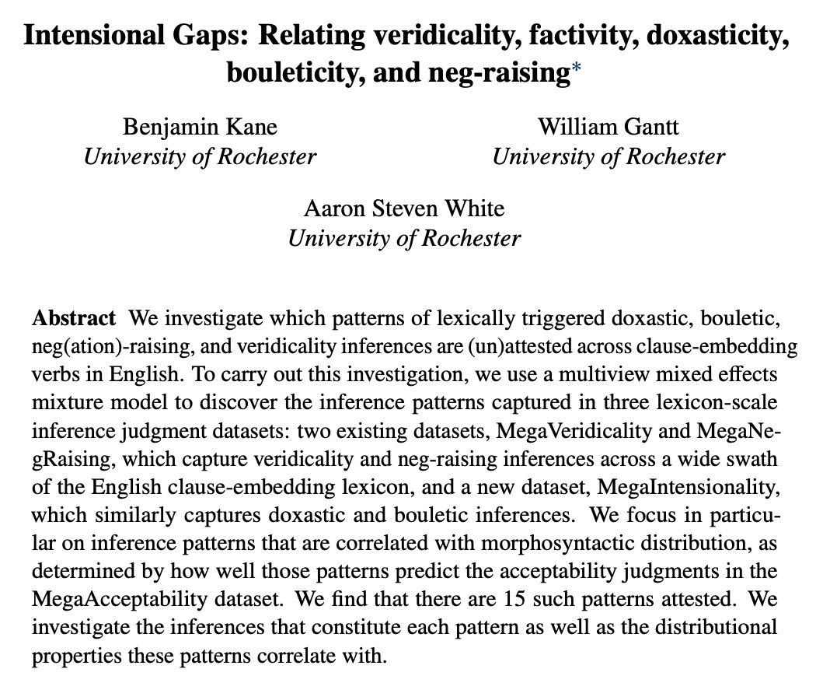

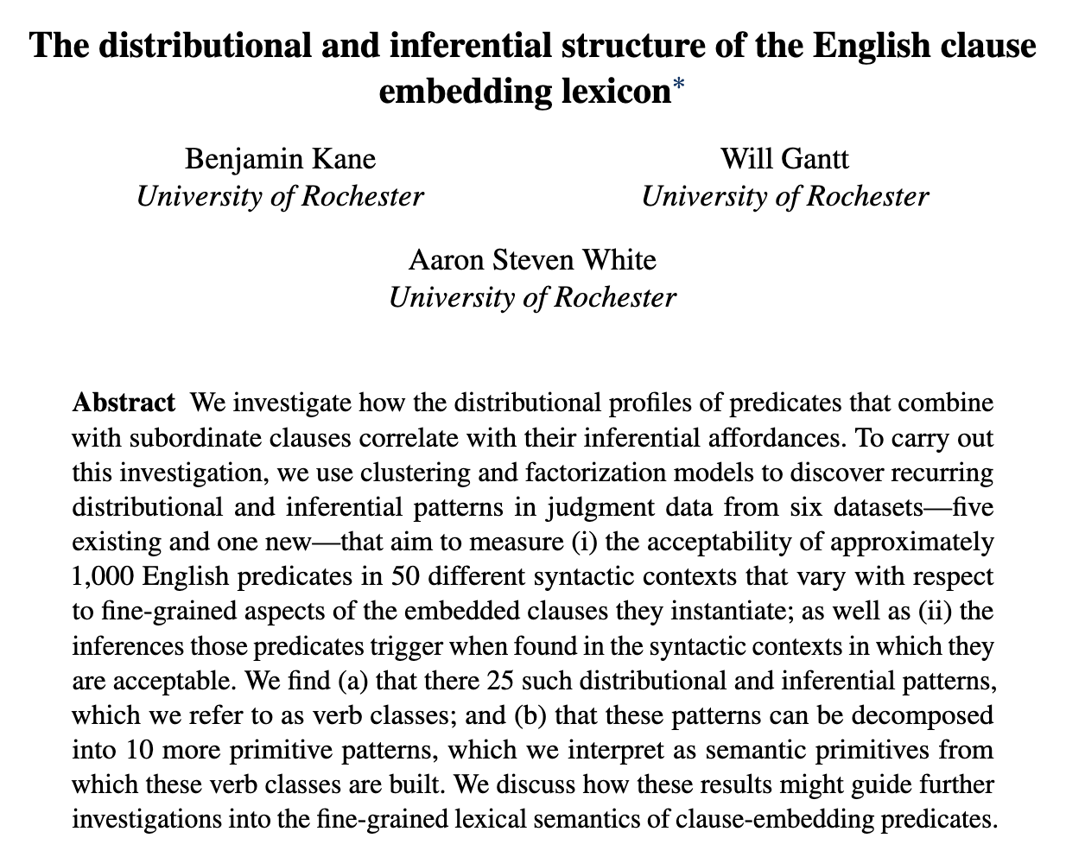

In preparation!
Ben Kane
OpenStream.AI
Will Gantt
Johns Hopkins University

Slide 36
Measuring Distribution

Slide 37
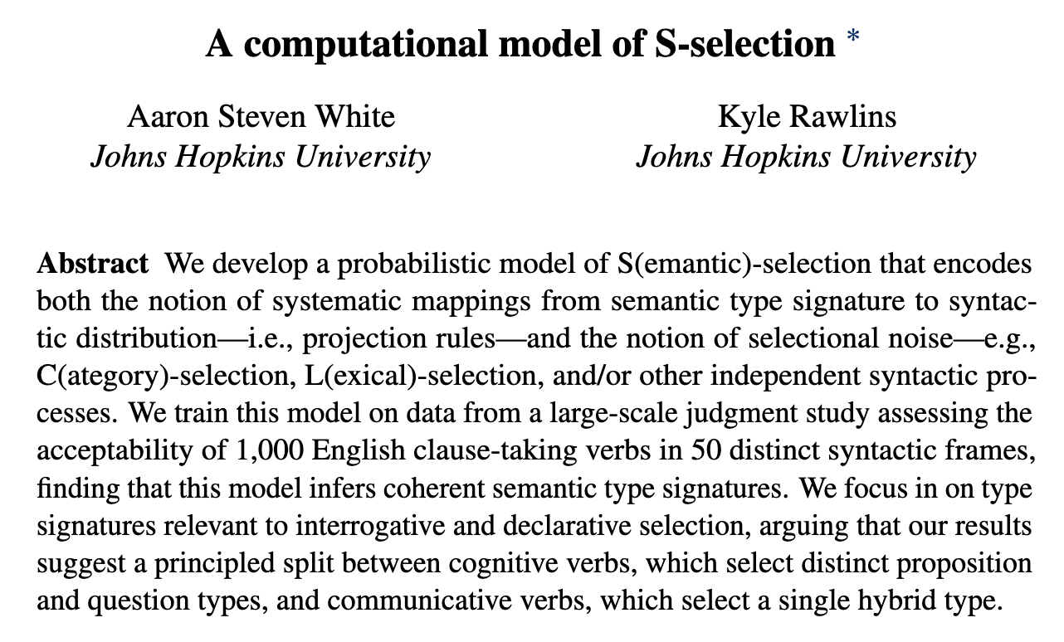
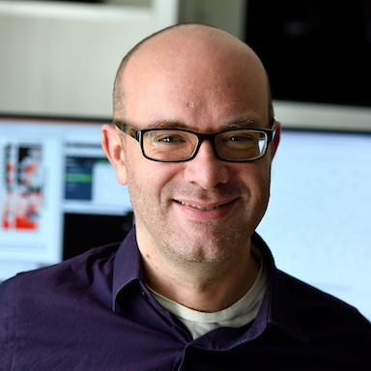
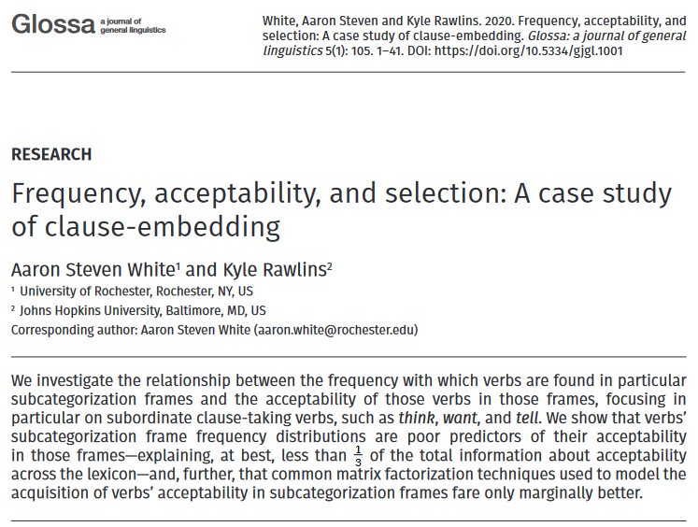
Kyle Rawlins
Johns Hopkins University

Slide 38
MegaAcceptability Dataset
Acceptability for 1,000 verbs in 50 syntactic frames focused on clause-embedding.

Slide 39
Verbs
think
know
wonder
love
surprise
tell
say
start
stop
...

Slide 40
Bleaching Method
Frame templates (e.g. NP __ that S) instantiated by semantically bleached fillers.

Slide 41
Verbs
Frames
think
Someone __ed something happened
know
Someone __ed that something happened
wonder
Someone __ed whether something happened
love
Someone __ed which someone something happened
x
surprise
Someone __ed someone that something happened
tell
Someone __ed someone whether something happened
say
Someone __ed to someone that something happened
start
Someone __ed to do something
stop
Someone __ed someone to do something
...
...

Slide 42
MegaAcceptability Dataset
Acceptability for 1,000 verbs in 50 syntactic frames focused on clause-embedding.
50,000 total items x 5 judgments per item

Slide 43
Question
Is bleaching a valid method for capturing the acceptability of a verb in a frame?

Slide 44
Validation Strategy #1 see Appendix A
Compare judgments for bleached items against judgments from trained linguists.
Validation Strategy #2 see Appendix B
Assess generalization drawn from linguist hand-coding of acceptability across many predicates.

Slide 45
Measuring Inference

Slide 46
Veridicality inference
(not)
NP V S ⇝ S
NP not V S ⇝ (not) S
Doxastic inference
NP V S ⇝ NP believe S
NP not V S ⇝ NP (not) believe S
(not)
Bouletic inference
NP V S ⇝ NP want S
NP not V S ⇝ NP (not) want S
(not)
Neg-raising inference
NP not V S ⇝ NP V not S

Slide 47
Recipe
Validate a bleaching paradigm for collecting judgments for an inference type.
Select a set of frames of interest.
Select predicates acceptable in those frames using MegaAcceptability.
Collect judgments using the paradigm.

Slide 48
Veridicality task

Slide 49
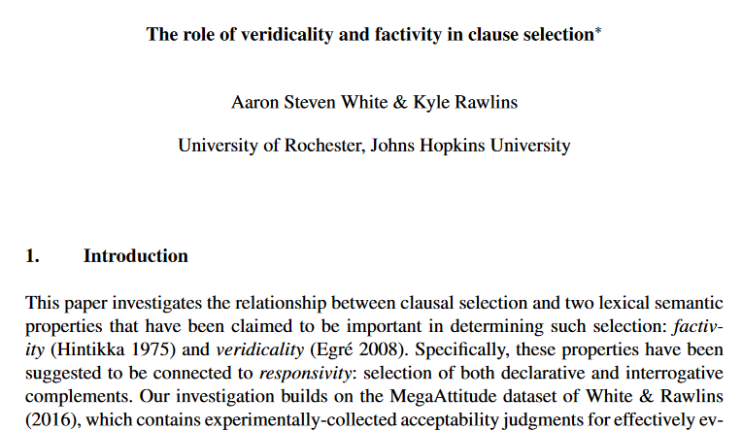
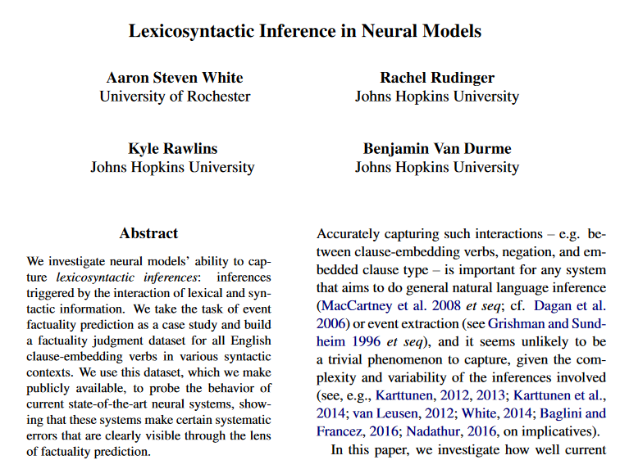
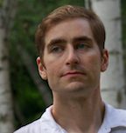
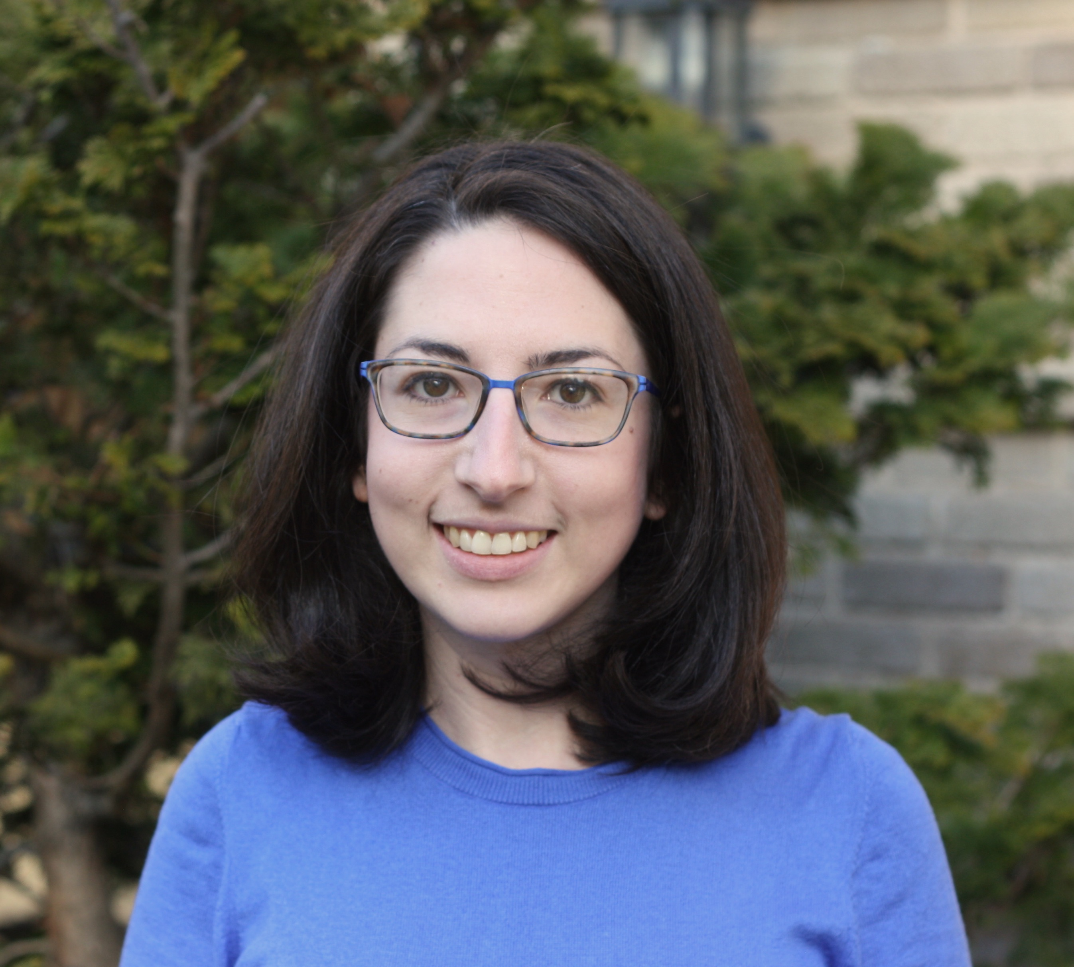
Kyle Rawlins
Johns Hopkins University
Ben Van Durme
Johns Hopkins University
Rachel Rudinger
University of Maryland

Slide 50
Someone was irritated that a particular thing happened.
Veridicality task
Did that thing happen?
no maybe or maybe not yes

Slide 51
NP _ that S
Someone {knew, didn't know} that a particular thing happened.
NP be _ that S
Someone {was, wasn't} surprised that a particular thing happened.
NP _ for NP to VP
Someone {needed, didn’t need} for a particular thing to happen.
NP _ NP to VP[+/-eventive]
Someone {told, didn’t tell} a particular person to do a particular thing.
Someone {believed, didn’t believe} a particular person to have a particular thing.
NP be _ to VP[+/-eventive]
A particular person {was, wasn’t} excited to do a particular thing.
A particular person {was, wasn’t} suspected to have a particular thing.
NP _ to VP[+/-eventive]
A particular person {managed, didn’t manage} to do a particular thing.
A particular person {seemed, didn’t seem} to have a particular thing.

Slide 52
Neg-raising task

Slide 53
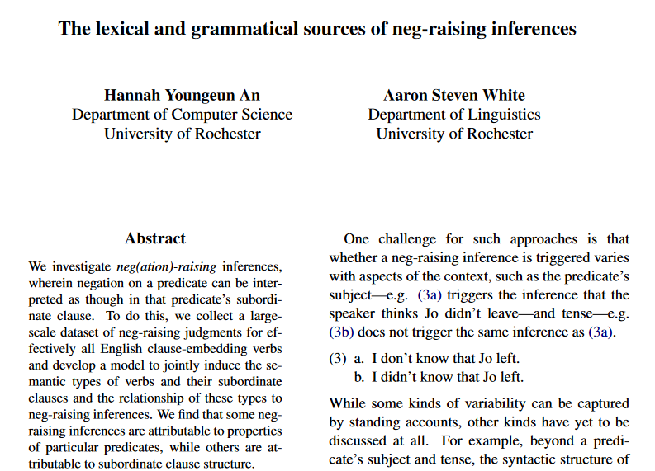
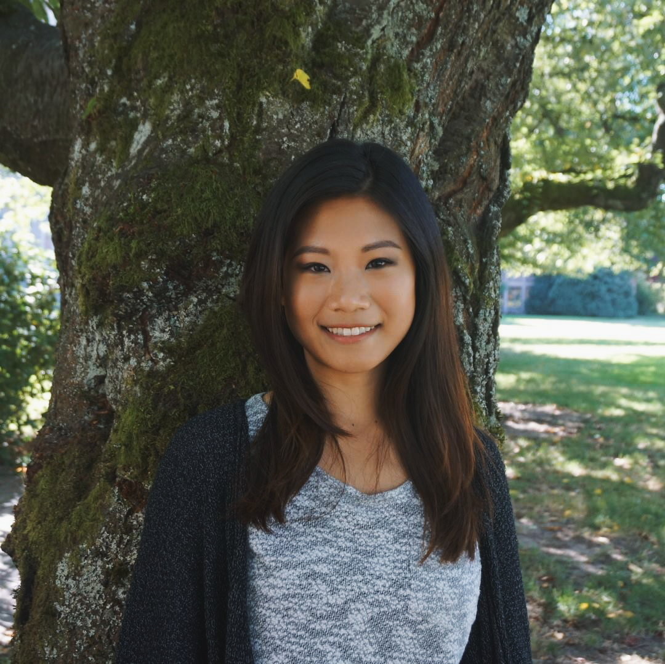
Hannah An
University of Rochester

Slide 54
If I were to say I don’t think that a particular thing happened, how likely is it that I mean I think that that thing didn’t happen?
Neg-raising task
Extremely unlikely
Extremely likely

Slide 55
NP _ that S
I {didn’t, don’t}
know that a particular thing happened.
A particular person {didn’t, doesn’t}
NP be _ that S
I {wasn’t, ‘m not}
surprised that a particular thing happened.
A particular person {wasn’t, isn’t}
NP be _ to VP[+/-eventive]
I {wasn’t, ‘m not}
told to do a particular thing.
A particular person {wasn’t, isn’t}
believed to have a particular thing.
NP _ to VP[+/-eventive]
I {didn’t, don’t}
managed to do a particular thing.
A particular person {didn’t, doesn’t}
seemed to have a particular thing.

Slide 56
Belief task

Slide 57
Ben Kane
OpenStream.AI
Will Gantt
Johns Hopkins University

Slide 58
If A knew that C happened, how likely is it that A believed that C happened?
Belief task
Extremely unlikely
Extremely likely

Slide 59
If A persuaded B that C happened, how likely is it that B believed that C happened?
Belief task
Extremely unlikely
Extremely likely

Slide 60
If A was appalled that C happened, how likely is it that A wanted C to have happened?
Desire task
Extremely unlikely
Extremely likely

Slide 61
If A apologized to B that C happened, how likely is it that B wanted C to have happened?
Desire task
Extremely unlikely
Extremely likely

Slide 62
NP _ that S
A {knew, didn't know} that C happened.
NP _ NP that S
A {told, didn't tell} B that C happened.
NP _ to NP that S
A {said, didn't say} to B that C happened.
NP _ that S
A {was, wasn’t} surprised that C happened.
NP _ that S[+future]
A {hoped, didn't hope} that C would happen.
NP _ NP that S[+future]
A {promised, didn't promise} B that C would happen.
NP _ to NP that S[+future]
A {predicted, didn't predict} to B that C would happen.
NP _ that S[+future]
A {was, wasn’t} excited that C would happen.

Slide 63
In preparation!
Ben Kane
OpenStream.AI
Will Gantt
Johns Hopkins University

Slide 64
NP _ for NP to VP
A {wanted, didn’t want} for B to do C.
NP _ to VP[+/-eventive]
A {hoped, didn’t hope} to {do, have} C.
NP _ NP to VP[+/-eventive]
A {told, didn't tell} B to {do, have} C.
NP _ to NP to VP[+/-eventive]
A {said, didn't say} to B to {do, have} C.
NP be _ to VP[+/-eventive]
A {was, wasn’t} believed to {do, have} C.
NP _ NP VP
A {saw, didn’t see} B do C.
NP _ VPing
A {liked, didn’t like} doing C.

Slide 65
If A chose to do C, how likely is it that A intended to do C?
Intention task
Extremely unlikely
Extremely likely

Slide 66
Question
Is bleaching a valid method for capturing inferences associated with a verb in a frame?

Slide 67
Validation Strategy #1 see Appendix C
Compare judgments for bleached items against judgments from trained linguists.
Validation Strategy #2 see Appendix D
Compare judgments for bleached items to judgments for more contentful items.
Validation Strategy #3 see Appendix E
Compare inference judgments for bleached items to acceptability judgments for distributional diagnostic.

Slide 68
Discovering Inference Patterns

Slide 69
Approach
Cluster predicate-frame pairs in inference space using a multiview mixed effects mixture model.

Slide 70
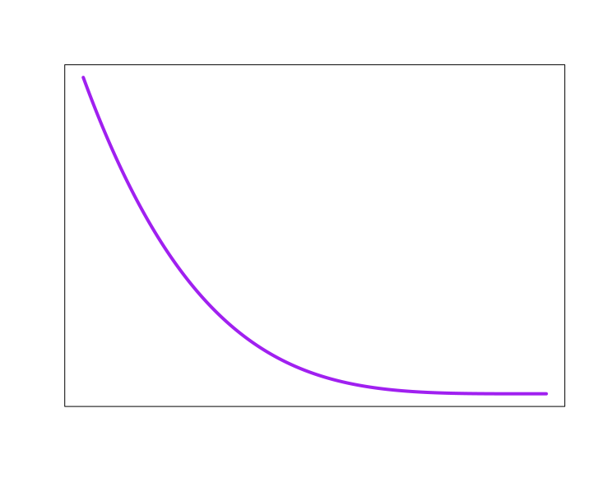
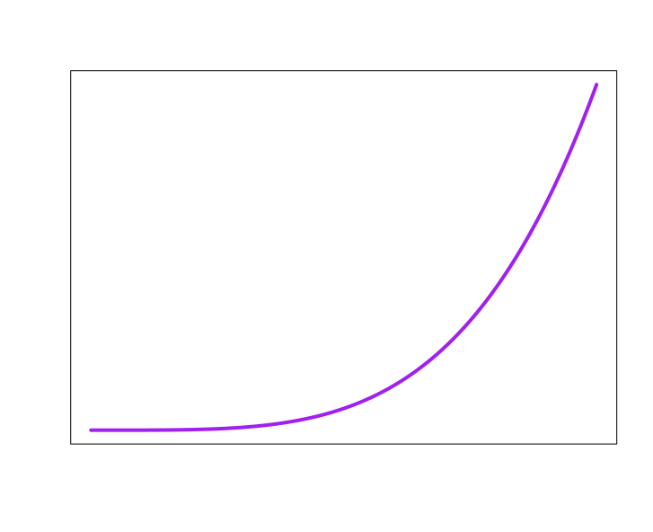

Inference +
distribution patterns
know
NP _ S
1
2
3
4
5
6
10
11
7
8
9
12
Acceptability
Neg-raising
5
4
1
3
6
Belief
2
7
Desire
Intention
Veridicality
NP[3s] not _ S
NP_ S
NP _ S
NP _ S
NP _ S
0
1
0
1
0
1
0
1
no
maybe
yes

Slide 71
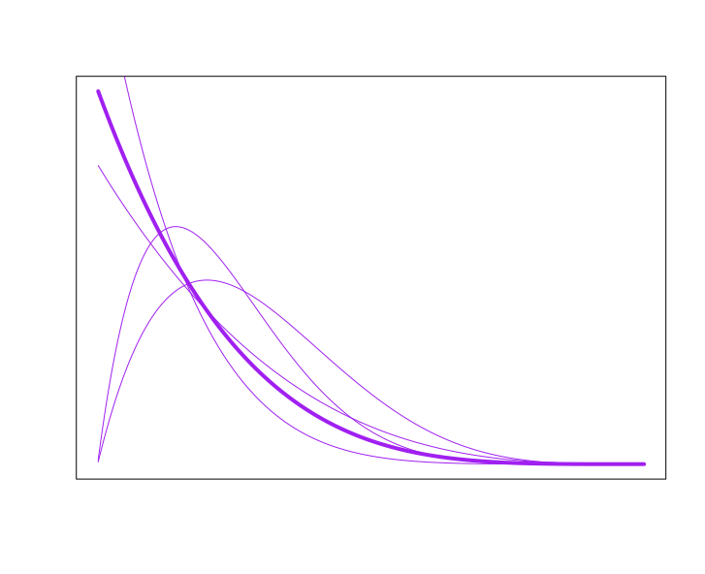
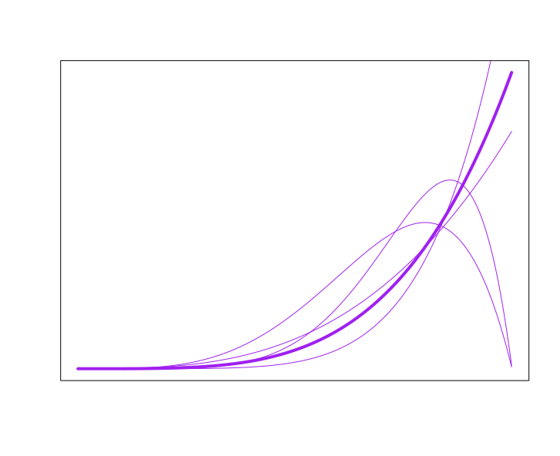
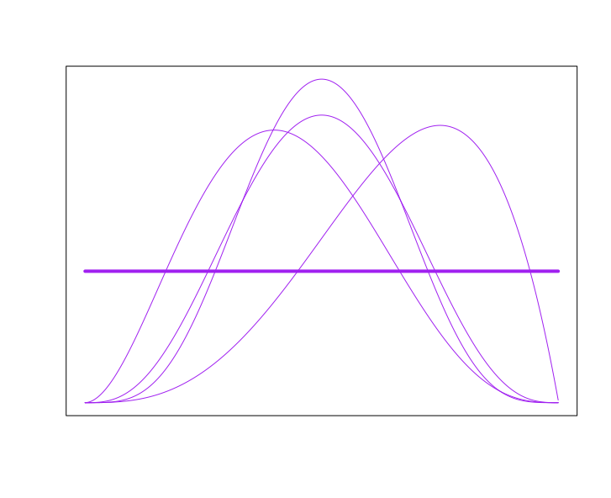
Inference +
distribution patterns
know
NP _ S
1
2
3
4
5
6
10
11
7
8
9
12
Acceptability
Neg-raising
5
4
1
3
6
Belief
2
7
Desire
Intention
Veridicality
NP[3s] not _ S
NP_ S
NP _ S
NP _ S
NP _ S
0
1
0
1
0
1
0
1
no
maybe
yes

Slide 72
All frames simultaneously!!!
Inference +
distribution patterns
know
1
2
3
4
5
6
10
11
7
8
9
12
Acceptability
Neg-raising
5
4
1
3
6
Belief
2
7
5
4
Desire
1
3
6
Intention
Veridicality
2
7
5
4
1
3
6
2
7
5
4
1
3
6
2
7
5
4
1
3
6
2
7
0
1
0
1
0
1
0
1
no
maybe
yes
0
1
0
1
0
1
0
1
no
maybe
yes
0
1
0
1
0
1
0
1
no
maybe
yes
0
1
0
1
0
1
0
1
no
maybe
yes
0
1
0
1
0
1
0
1
no
maybe
yes

Slide 73
Method
Fit model to all data in MegaAcceptability, MegaVeridicality, MegaNegRaising, and MegaIntensionality using MAP estimation.

Slide 74
Output
A distribution over inference + distribution patterns for each verb.

Slide 75
Inference +
distribution patterns
know
1
2
3
4
5
6
10
11
7
8
9
12
Acceptability
Neg-raising
5
4
1
3
6
Belief
2
7
5
4
Desire
1
3
6
Intention
Veridicality
2
7
5
4
1
3
6
2
7
5
4
1
3
6
2
7
5
4
1
3
6
2
7
0
1
0
1
0
1
0
1
no
maybe
yes
0
1
0
1
0
1
0
1
no
maybe
yes
0
1
0
1
0
1
0
1
no
maybe
yes
0
1
0
1
0
1
0
1
no
maybe
yes
0
1
0
1
0
1
0
1
no
maybe
yes

Slide 76
Output
A distribution over inference + distribution patterns for each verb.
For each inference pattern, distributions over judgments for each frame and inference type.

Slide 77
Inference +
distribution patterns
know
1
2
3
4
5
6
10
11
7
8
9
12
Acceptability
Neg-raising
5
4
1
3
6
Belief
2
7
5
4
Desire
1
3
6
Intention
Veridicality
2
7
5
4
1
3
6
2
7
5
4
1
3
6
2
7
5
4
1
3
6
2
7
0
1
0
1
0
1
0
1
no
maybe
yes
0
1
0
1
0
1
0
1
no
maybe
yes
0
1
0
1
0
1
0
1
no
maybe
yes
0
1
0
1
0
1
0
1
no
maybe
yes
0
1
0
1
0
1
0
1
no
maybe
yes

Slide 78
Question
How many inference patterns should we assume exist?
Idea
Only as many as we need to predict judgments for verb-frame-judgment type tuples we have not observed when fitting the model.

Slide 79
Implementation
Select the smallest clustering for which no larger clustering improves prediction of held-out tuples.

Slide 80
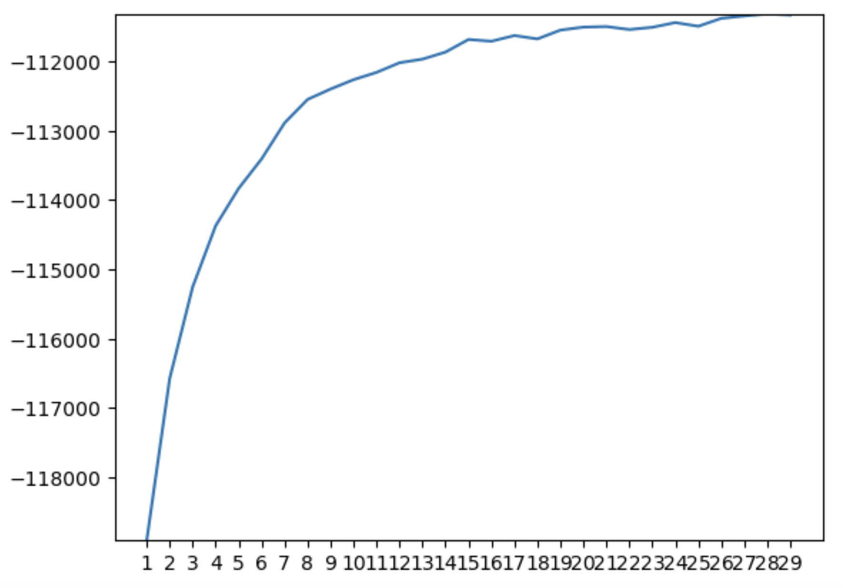
Likelihood of head out data
# of inference + distribution patterns

Slide 81
Implementation
Select the smallest clustering for which no larger clustering improves prediction of held-out tuples.
Idea
Optimal number of inference + distribution patterns is 25.

Slide 82
Likelihood of head out data
# of inference + distribution patterns

Slide 83
Interpretation
There are at least 25 distributionally correlated inference patterns.
Important Point #1
Not all inference + distribution patterns instantiated by particular predicates will get their own inference pattern.
Important Point #2
Enriching the distributional representation or range of inferences could increase the granularity of the patterns.

Slide 84
Analyzing Patterns

Slide 85
Part 1
Examples of which predicates participate in which patterns and what those patterns look like.

Slide 86
Inference +
distribution patterns
Which predicates have high probability for a pattern?
know
1
2
3
4
5
6
10
11
7
8
9
12
Acceptability
Neg-raising
5
4
1
3
6
Belief
2
7
5
4
Desire
1
3
6
Intention
Veridicality
2
7
5
4
1
3
6
2
7
5
4
1
3
6
2
7
5
4
1
3
6
2
7
0
1
0
1
0
1
0
1
no
maybe
yes
0
1
0
1
0
1
0
1
no
maybe
yes
0
1
0
1
0
1
0
1
no
maybe
yes
0
1
0
1
0
1
0
1
no
maybe
yes
0
1
0
1
0
1
0
1
no
maybe
yes

Slide 87
What is the expected value of each distribution?
Inference +
distribution patterns
know
1
2
3
4
5
6
10
11
7
8
9
12
Acceptability
Neg-raising
5
4
1
3
6
Belief
2
7
5
4
Desire
1
3
6
Intention
Veridicality
2
7
5
4
1
3
6
2
7
5
4
1
3
6
2
7
5
4
1
3
6
2
7
0
1
0
1
0
1
0
1
no
maybe
yes
0
1
0
1
0
1
0
1
no
maybe
yes
0
1
0
1
0
1
0
1
no
maybe
yes
0
1
0
1
0
1
0
1
no
maybe
yes
0
1
0
1
0
1
0
1
no
maybe
yes

Slide 88
Names given by analyst based on manual analysis!
Inference +
distribution patterns
know
1
2
3
4
5
6
10
11
7
8
9
12
Acceptability
Neg-raising
5
4
1
3
6
Belief
2
7
5
4
Desire
1
3
6
Intention
Veridicality
2
7
5
4
1
3
6
2
7
5
4
1
3
6
2
7
5
4
1
3
6
2
7
0
1
0
1
0
1
0
1
no
maybe
yes
0
1
0
1
0
1
0
1
no
maybe
yes
0
1
0
1
0
1
0
1
no
maybe
yes
0
1
0
1
0
1
0
1
no
maybe
yes
0
1
0
1
0
1
0
1
no
maybe
yes

Slide 89
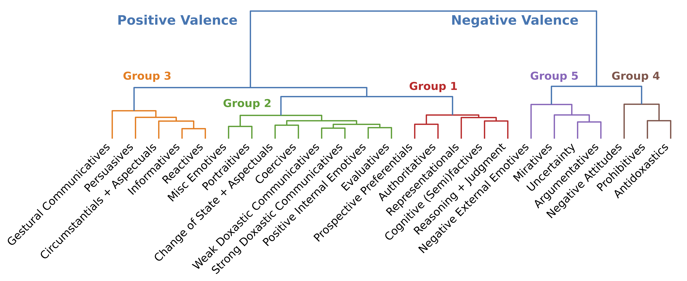
Purely for exposition!
Derived by hierarchical clustering based on expected value of inference distributions.

Slide 90
Upshot
Well-studied classes of predicates reveal themselves quite clearly.
Question
How do we use the gaps in the observed patterns to help us develop deeper generalizations about lexicalization?

Slide 91
Part 1
Examples of which predicates participate in which patterns and what those patterns look like.
Part 2
Develop auxiliary model for extracting generalizations by decomposing patterns into components.

Slide 92
Analyzing Patterns
Example patterns

Slide 93
discover, realize, recognize, know, find out, understand, …

Slide 95
discovered
realized
recognized
knew
…
Someone that a particular thing happened.
That thing happened.

Slide 96
discover
realize
recognize
know
…
Someone didn’t that a particular thing happened.
That thing happened.

Slide 98
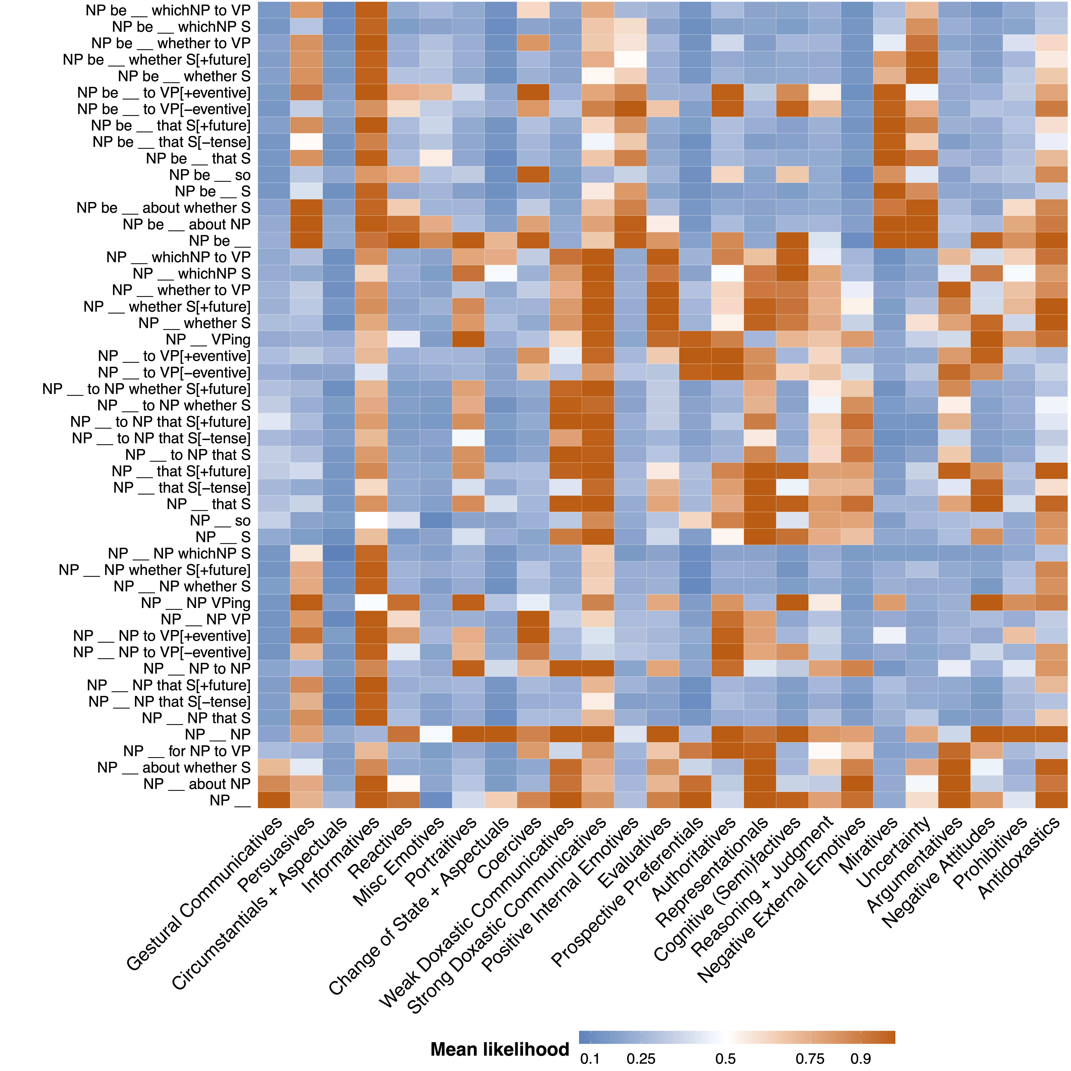

Slide 99
discovered
realized
recognized
knew
…
Someone that something happened.

Slide 100
discovered
realized
recognized
knew
…
*Someone was that something happened.

Slide 101
dream, hope, think, agree, assume, …

Slide 102
dreamed hoped
thought assumed
…
Someone (*was) that something happened.

Slide 103
dream
hope
think assume
…
Someone did(n’t) that a particular thing happened.
x
That thing happened.

Slide 104
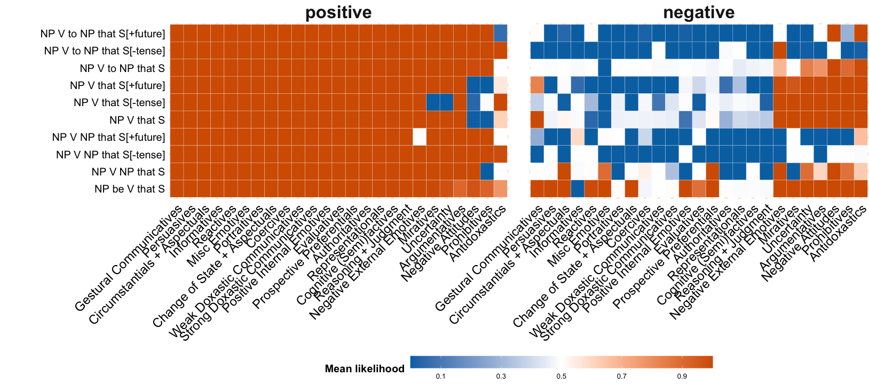
discovered
realized
recognized
knew
…
A that C happened.
A believed that C happened.

Slide 105
discover
realize
recognize
know
…
A didn’t that C happened.
x
A believed that C happened.

Slide 106
dreamed
hoped
thought assumed
…
A that C happened.
A believed that C happened.

Slide 107
be contented, be relieved, be amused, be charmed, be pleased, be comforted, …

Slide 108
pleased
relieved
amused
charmed
…
Someone was(n’t) that a particular thing happened.
That thing happened.

Slide 109
pleased
relieved
amused
charmed
…
A was(n’t) that C happened.
A believed that C happened.

Slide 110
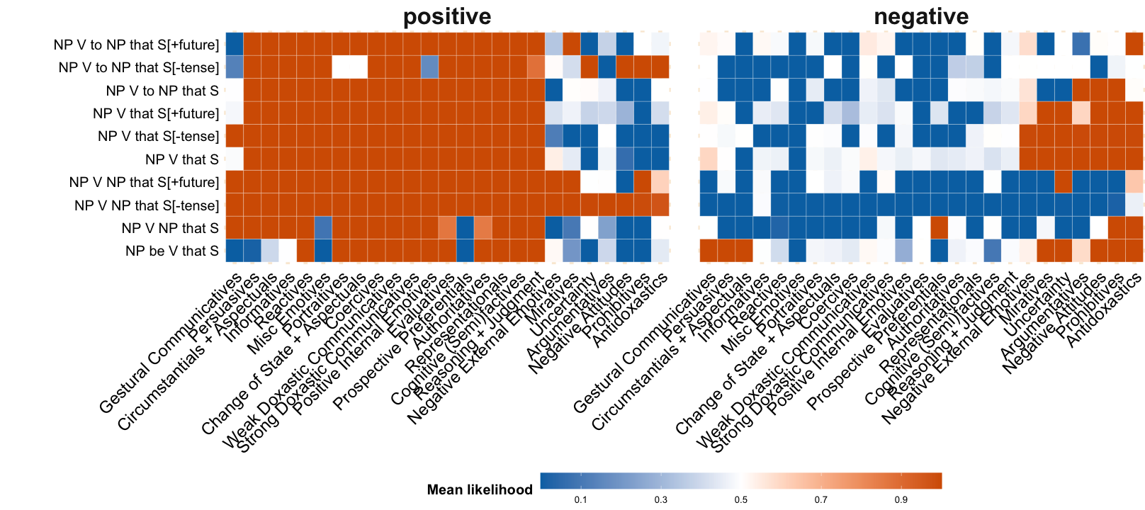
pleased
relieved
amused
charmed
…
A was that C happened.
A wanted C to have happened.

Slide 111
pleased
relieved
amused
charmed
…
A wasn’t that C happened.
x
A wanted C to have happened.

Slide 112
?
aim, appear, compete, hunger, try, lust, attempt, start, …
?

Slide 113
manage, glean, opt, presuppose, signify, conclude, …
?

Slide 114
Upshot
Well-studied classes of predicates reveal themselves quite clearly.
Question
How do we use the gaps in the observed patterns to help us develop deeper generalizations about lexicalization?

Slide 115
Analyzing Patterns
Discovering generalizations

Slide 116
Intuition see Dowty 1979 et seq.
Inference patterns associated with predicate class result from “summing across” inference patterns associated with semantic primitives shared by predicates in the class.

Slide 117
Idea
Develop model that “factors” inference patterns to discover semantic primitives.

Slide 118
Cognitive Semifactive
Inference +
distribution patterns
know
1
2
3
4
5
6
10
11
7
8
9
12
Acceptability
Neg-raising
5
4
1
3
6
Belief
2
7
5
4
Desire
1
3
6
Intention
Veridicality
2
7
5
4
1
3
6
2
7
5
4
1
3
6
2
7
5
4
1
3
6
2
7
0
1
0
1
0
1
0
1
no
maybe
yes
0
1
0
1
0
1
0
1
no
maybe
yes
0
1
0
1
0
1
0
1
no
maybe
yes
0
1
0
1
0
1
0
1
no
maybe
yes
0
1
0
1
0
1
0
1
no
maybe
yes

Slide 119
Need not sum to 1 since class may be constructed from multiple primitives!
Cognitive Semifactive
Semantic Primitives
Probability class is constructed from semantic primitive
1
2
3
4
5
6
10
11
7
8
9
12
Acceptability
Neg-raising
5
4
1
3
6
Belief
2
7
5
4
Desire
1
3
6
Intention
Veridicality
2
7
5
4
1
3
6
2
7
5
4
1
3
6
2
7
5
4
1
3
6
2
7
0
1
0
1
0
1
0
1
no
maybe
yes
0
1
0
1
0
1
0
1
no
maybe
yes
0
1
0
1
0
1
0
1
no
maybe
yes
0
1
0
1
0
1
0
1
no
maybe
yes
0
1
0
1
0
1
0
1
no
maybe
yes

Slide 120
Cognitive Semifactive
Semantic Primitives
Each primitive is associated with some inference pattern.
1
2
3
4
5
6
10
11
7
8
9
12
Acceptability
Neg-raising
5
4
1
3
6
Belief
2
7
5
4
Desire
1
3
6
Intention
Veridicality
2
7
5
4
1
3
6
2
7
5
4
1
3
6
2
7
5
4
1
3
6
2
7
0
1
0
1
0
1
0
1
no
maybe
yes
0
1
0
1
0
1
0
1
no
maybe
yes
0
1
0
1
0
1
0
1
no
maybe
yes
0
1
0
1
0
1
0
1
no
maybe
yes
0
1
0
1
0
1
0
1
no
maybe
yes

Slide 121
discover
realize
recognize
know
…
FRAME +
x
A believed that C happened.

Slide 122
Cognitive Semifactive
Semantic Primitives
Sum inference pattern associated with each primitive.
1
2
3
4
5
6
10
11
7
8
9
12
Belief
0
1

Slide 123
Idea
Develop model that “factors” inference patterns to discover semantic primitives.
Implementation
Fuzzy logic factorization of the inference and acceptability distributions fit using MAP estimation.

Slide 124
Question
How many primitives should we assume exist?
Idea
Stop when the error stops in reconstructing the inference and acceptability distributions stops improving much.

Slide 125
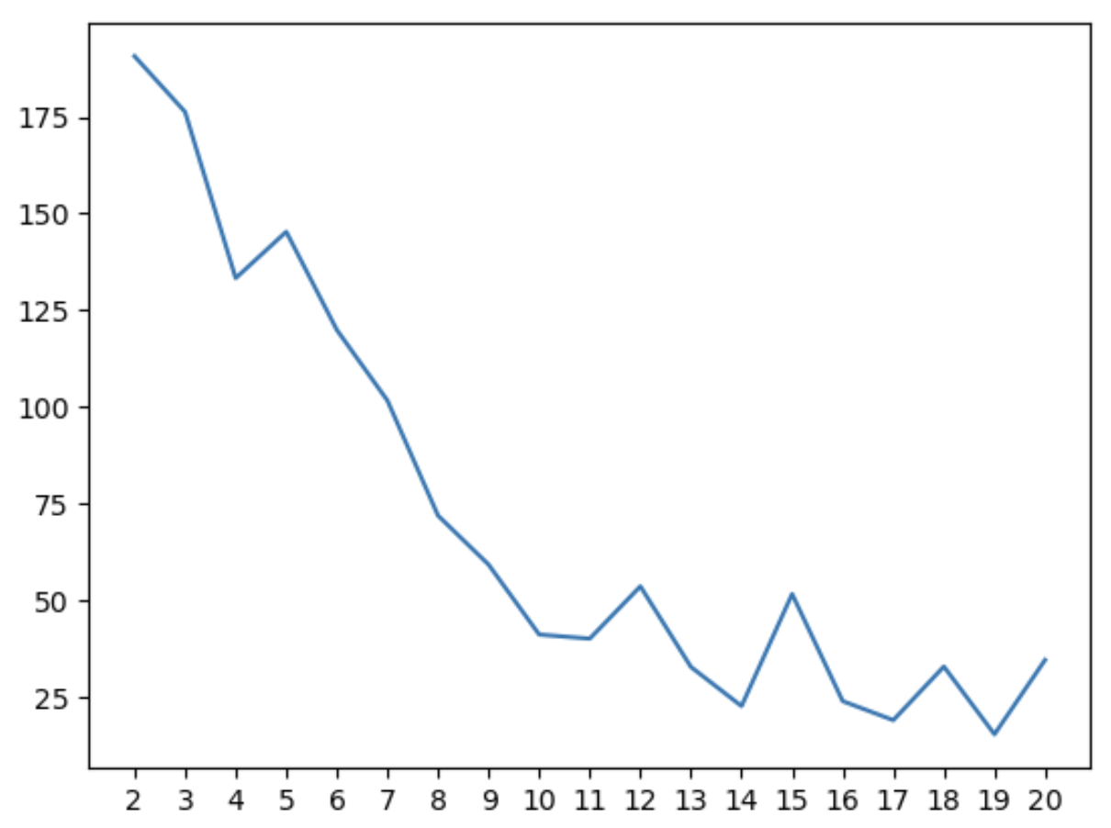
Error
# of semantic primitives

Slide 126
Cognitive Semifactive
Semantic Primitives
Which classes have high probability for a primitive?
1
2
3
4
5
6
10
11
7
8
9
12
Acceptability
Neg-raising
5
4
1
3
6
Belief
2
7
5
4
Desire
1
3
6
Intention
Veridicality
2
7
5
4
1
3
6
2
7
5
4
1
3
6
2
7
5
4
1
3
6
2
7
0
1
0
1
0
1
0
1
no
maybe
yes
0
1
0
1
0
1
0
1
no
maybe
yes
0
1
0
1
0
1
0
1
no
maybe
yes
0
1
0
1
0
1
0
1
no
maybe
yes
0
1
0
1
0
1
0
1
no
maybe
yes

Slide 127
What is the expected value of each distribution?
Cognitive Semifactive
Semantic Primitives
1
2
3
4
5
6
10
11
7
8
9
12
Acceptability
Neg-raising
5
4
1
3
6
Belief
2
7
5
4
Desire
1
3
6
Intention
Veridicality
2
7
5
4
1
3
6
2
7
5
4
1
3
6
2
7
5
4
1
3
6
2
7
0
1
0
1
0
1
0
1
no
maybe
yes
0
1
0
1
0
1
0
1
no
maybe
yes
0
1
0
1
0
1
0
1
no
maybe
yes
0
1
0
1
0
1
0
1
no
maybe
yes
0
1
0
1
0
1
0
1
no
maybe
yes

Slide 128
Names given by analyst based on manual analysis!
Cognitive Semifactive
Semantic Primitives
1
2
3
4
5
6
10
11
7
8
9
12
Acceptability
Neg-raising
5
4
1
3
6
Belief
2
7
5
4
Desire
1
3
6
Intention
Veridicality
2
7
5
4
1
3
6
2
7
5
4
1
3
6
2
7
5
4
1
3
6
2
7
0
1
0
1
0
1
0
1
no
maybe
yes
0
1
0
1
0
1
0
1
no
maybe
yes
0
1
0
1
0
1
0
1
no
maybe
yes
0
1
0
1
0
1
0
1
no
maybe
yes
0
1
0
1
0
1
0
1
no
maybe
yes

Slide 129
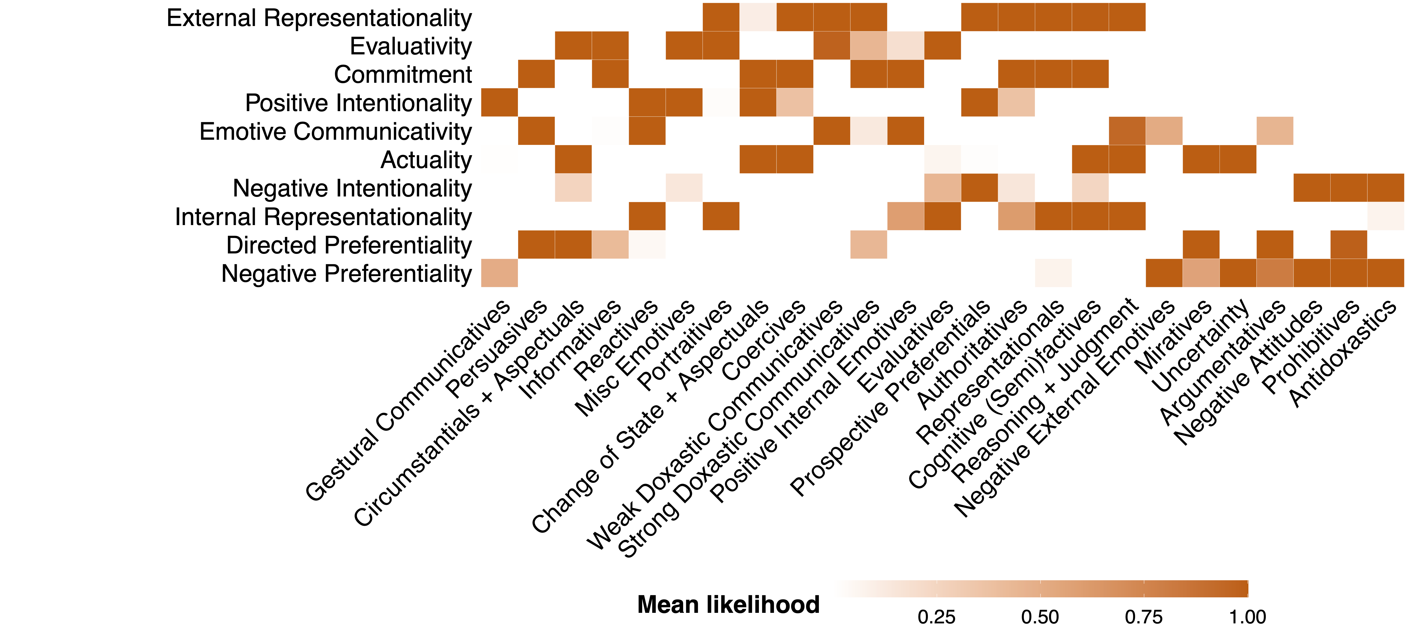

Slide 133
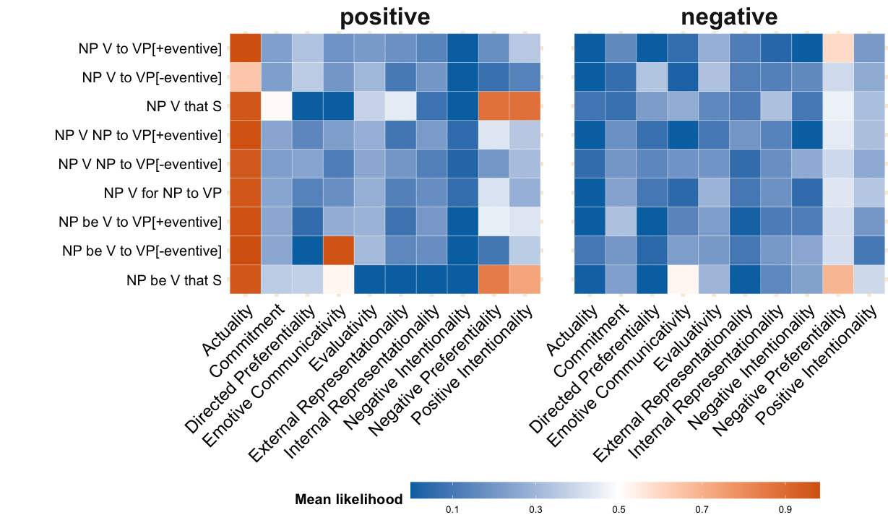
ACTUALITY implies VERIDICALITY

Slide 134
INTERNAL REPRESENTATIONALITY does not imply VERIDICALITY

Slide 135
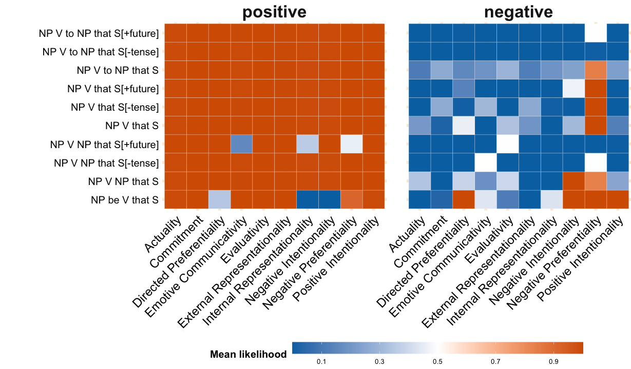
ACTUALITY implies BELIEF

Slide 136
INTERNAL REPRESENTATIONALITY implies BELIEF

Slide 137
Question
Where are the generalizations?
Idea
The primitives imply a basis whose span is the set of constructable inference patterns.

Slide 138
Question
Is there a way to construct a particular kind of inference pattern?
Case Study see Anand & Hacquard 2009
When a predicate has both belief and desire components, the belief component will be backgrounded.

Slide 139
BELIEF can be backgrounded…

Slide 140
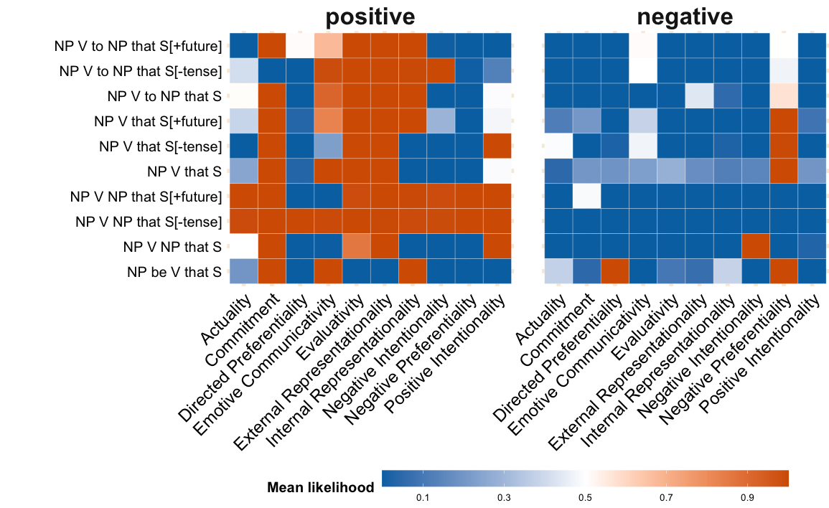
…but DESIRE cannot be…

Slide 141
…unless we combine components judicially.

Slide 142
Question
What are the constraints on combining certain kinds of semantic primitives?
Approach
Is an inference pattern ever actually constructed?

Slide 144
Analyzing Patterns
Discussion

Slide 145
Strong interpretation
If a particular pattern is never constructable according to the primitives, it is a lexical gap.
Weak interpretation
If a particular pattern is never constructed by combining primitives, it is a lexical gap.

Slide 146
Limitation #1
No representation of constraints on combinations of semantic primitives (if such constraints exist).
Limitation #2
Primitives may not be as “compact” as possible because we do not explicitly represent negation of primitives.
We have a model that does this but the results are…odd (in potentially interesting ways).

Slide 147
Future Direction #1
Understanding the mapping from primitives to syntactic structures (and thus how they correlate with distribution).

Slide 149
Future Direction #1
Understanding the mapping from primitives to syntactic structures (and thus how they correlate with distribution).
Future Direction #2
Understanding which patterns are construct{able, ed} when constraining to particular frames.

Slide 150
Conclusion

Slide 151
Question
What knowledge undergirds what we must mean in using an utterance?

Slide 152
Question
What types of concepts does language “see”?
Prior Work
For some areas of the lexicon, we have a solid understanding what language “sees”.

Slide 153
Challenge
As we expand to larger and more open classes of words, generalizations tend to be harder to find.
Example
Even in well-studied areas of the lexicons of well-studied languages, there remains debate about generalizations.

Slide 154
Empirical Challenge
To determine a pattern’s relative frequency we often have to take large samples of lexical item types and/or tokens.
Methodological Challenge
We need a way of detecting when a pattern is the result of “summing over” senses v. a product of a single sense.

Slide 155
Empirical Approach
Scale standard experimental methods to annotate large samples for inference + acceptability judgments.
Synthesizes multiple kinds of data into single representation
Methodological Approach
Develop and deploy multiview clustering and factorization methods that explicitly represent polysemy and other sources of “noise” in inference and distribution patterns.
Patterns should incorporate both inference and distribution to ensure that resulting clusters plausibly captures semantic classes.

Slide 156
Thanks!

Slide 157

Supported by NSF-BCS-1748969
The MegaAttitude Project: Investigating selection and polysemy at the scale of the lexicon

Slide 158
Appendix A
Acceptability Validation #1

Slide 159
Validation data
Select 30 verbs from across Hacquard & Wellwood's (2012) classification
Gather judgments for these verbs in all 50 syntactic frames from:
trained linguists
naïve speakers

Slide 160
Comparison
Correlation between judgments from LI and Sprouse et al.'s (2013) dataset

Slide 161
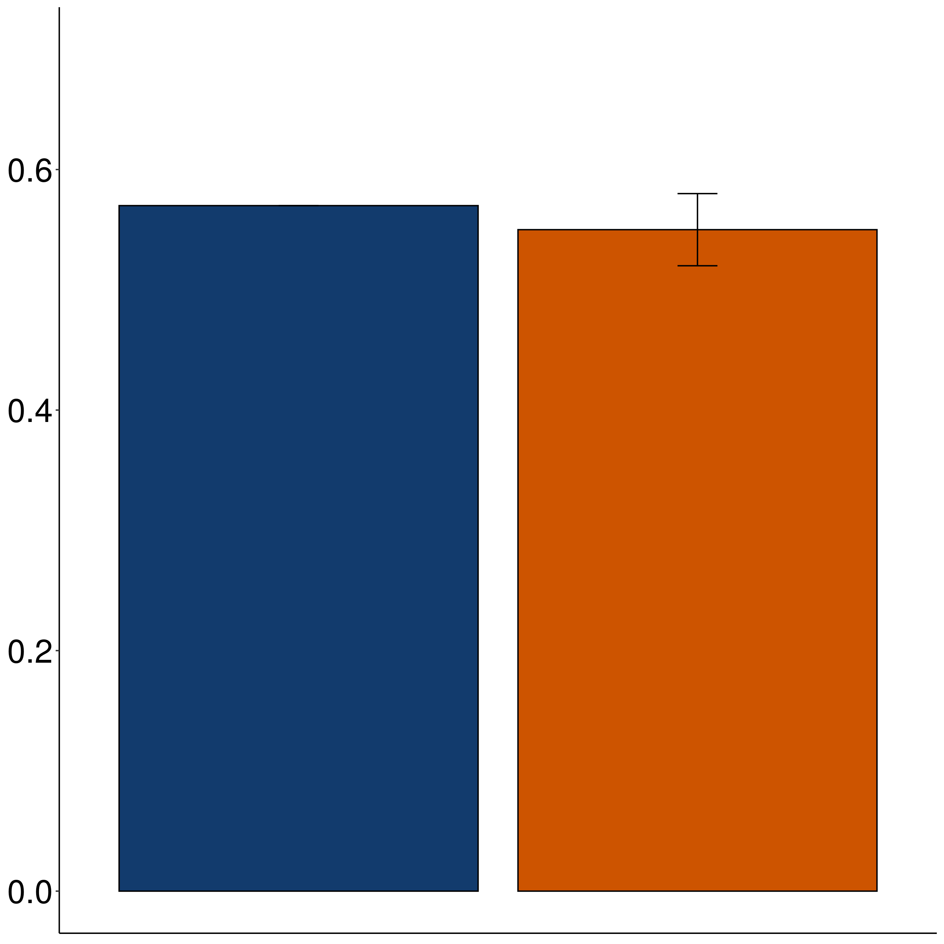
Correlation
Sprouse Linguistic Inquiry
MegaAcceptability

Slide 162
Appendix B
Acceptability Validation #2

Slide 163
Case Study The vast majority of about-PPs are adjuncts.
Rawlins 2013, 2014

Slide 164
XP₁ V (XP₂) (XP₃) about XP₄
is acceptable
X
XP₁ V (XP₂) (XP₃)
is acceptable

Slide 165
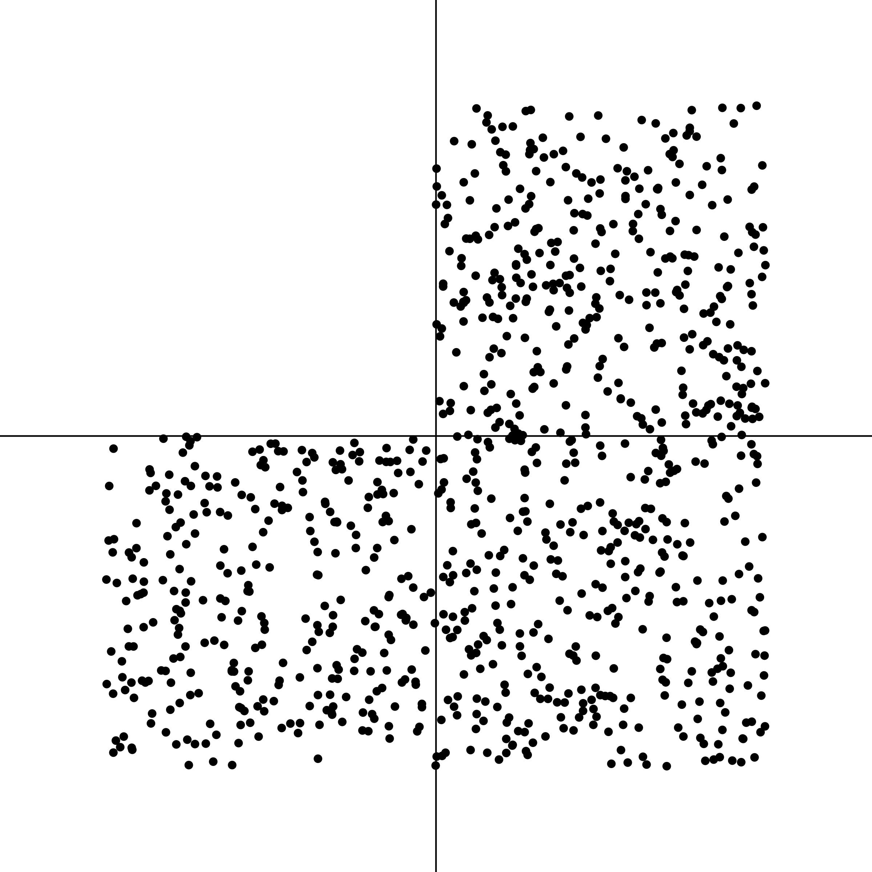

NP _ed about XP
NP _ed

Slide 166
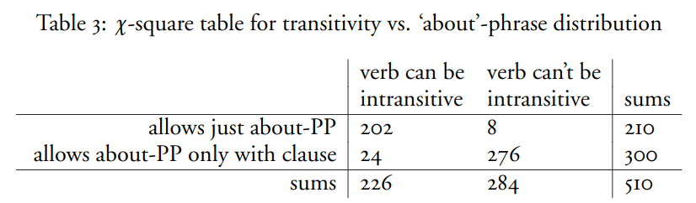
Rawlins 2014

Slide 167
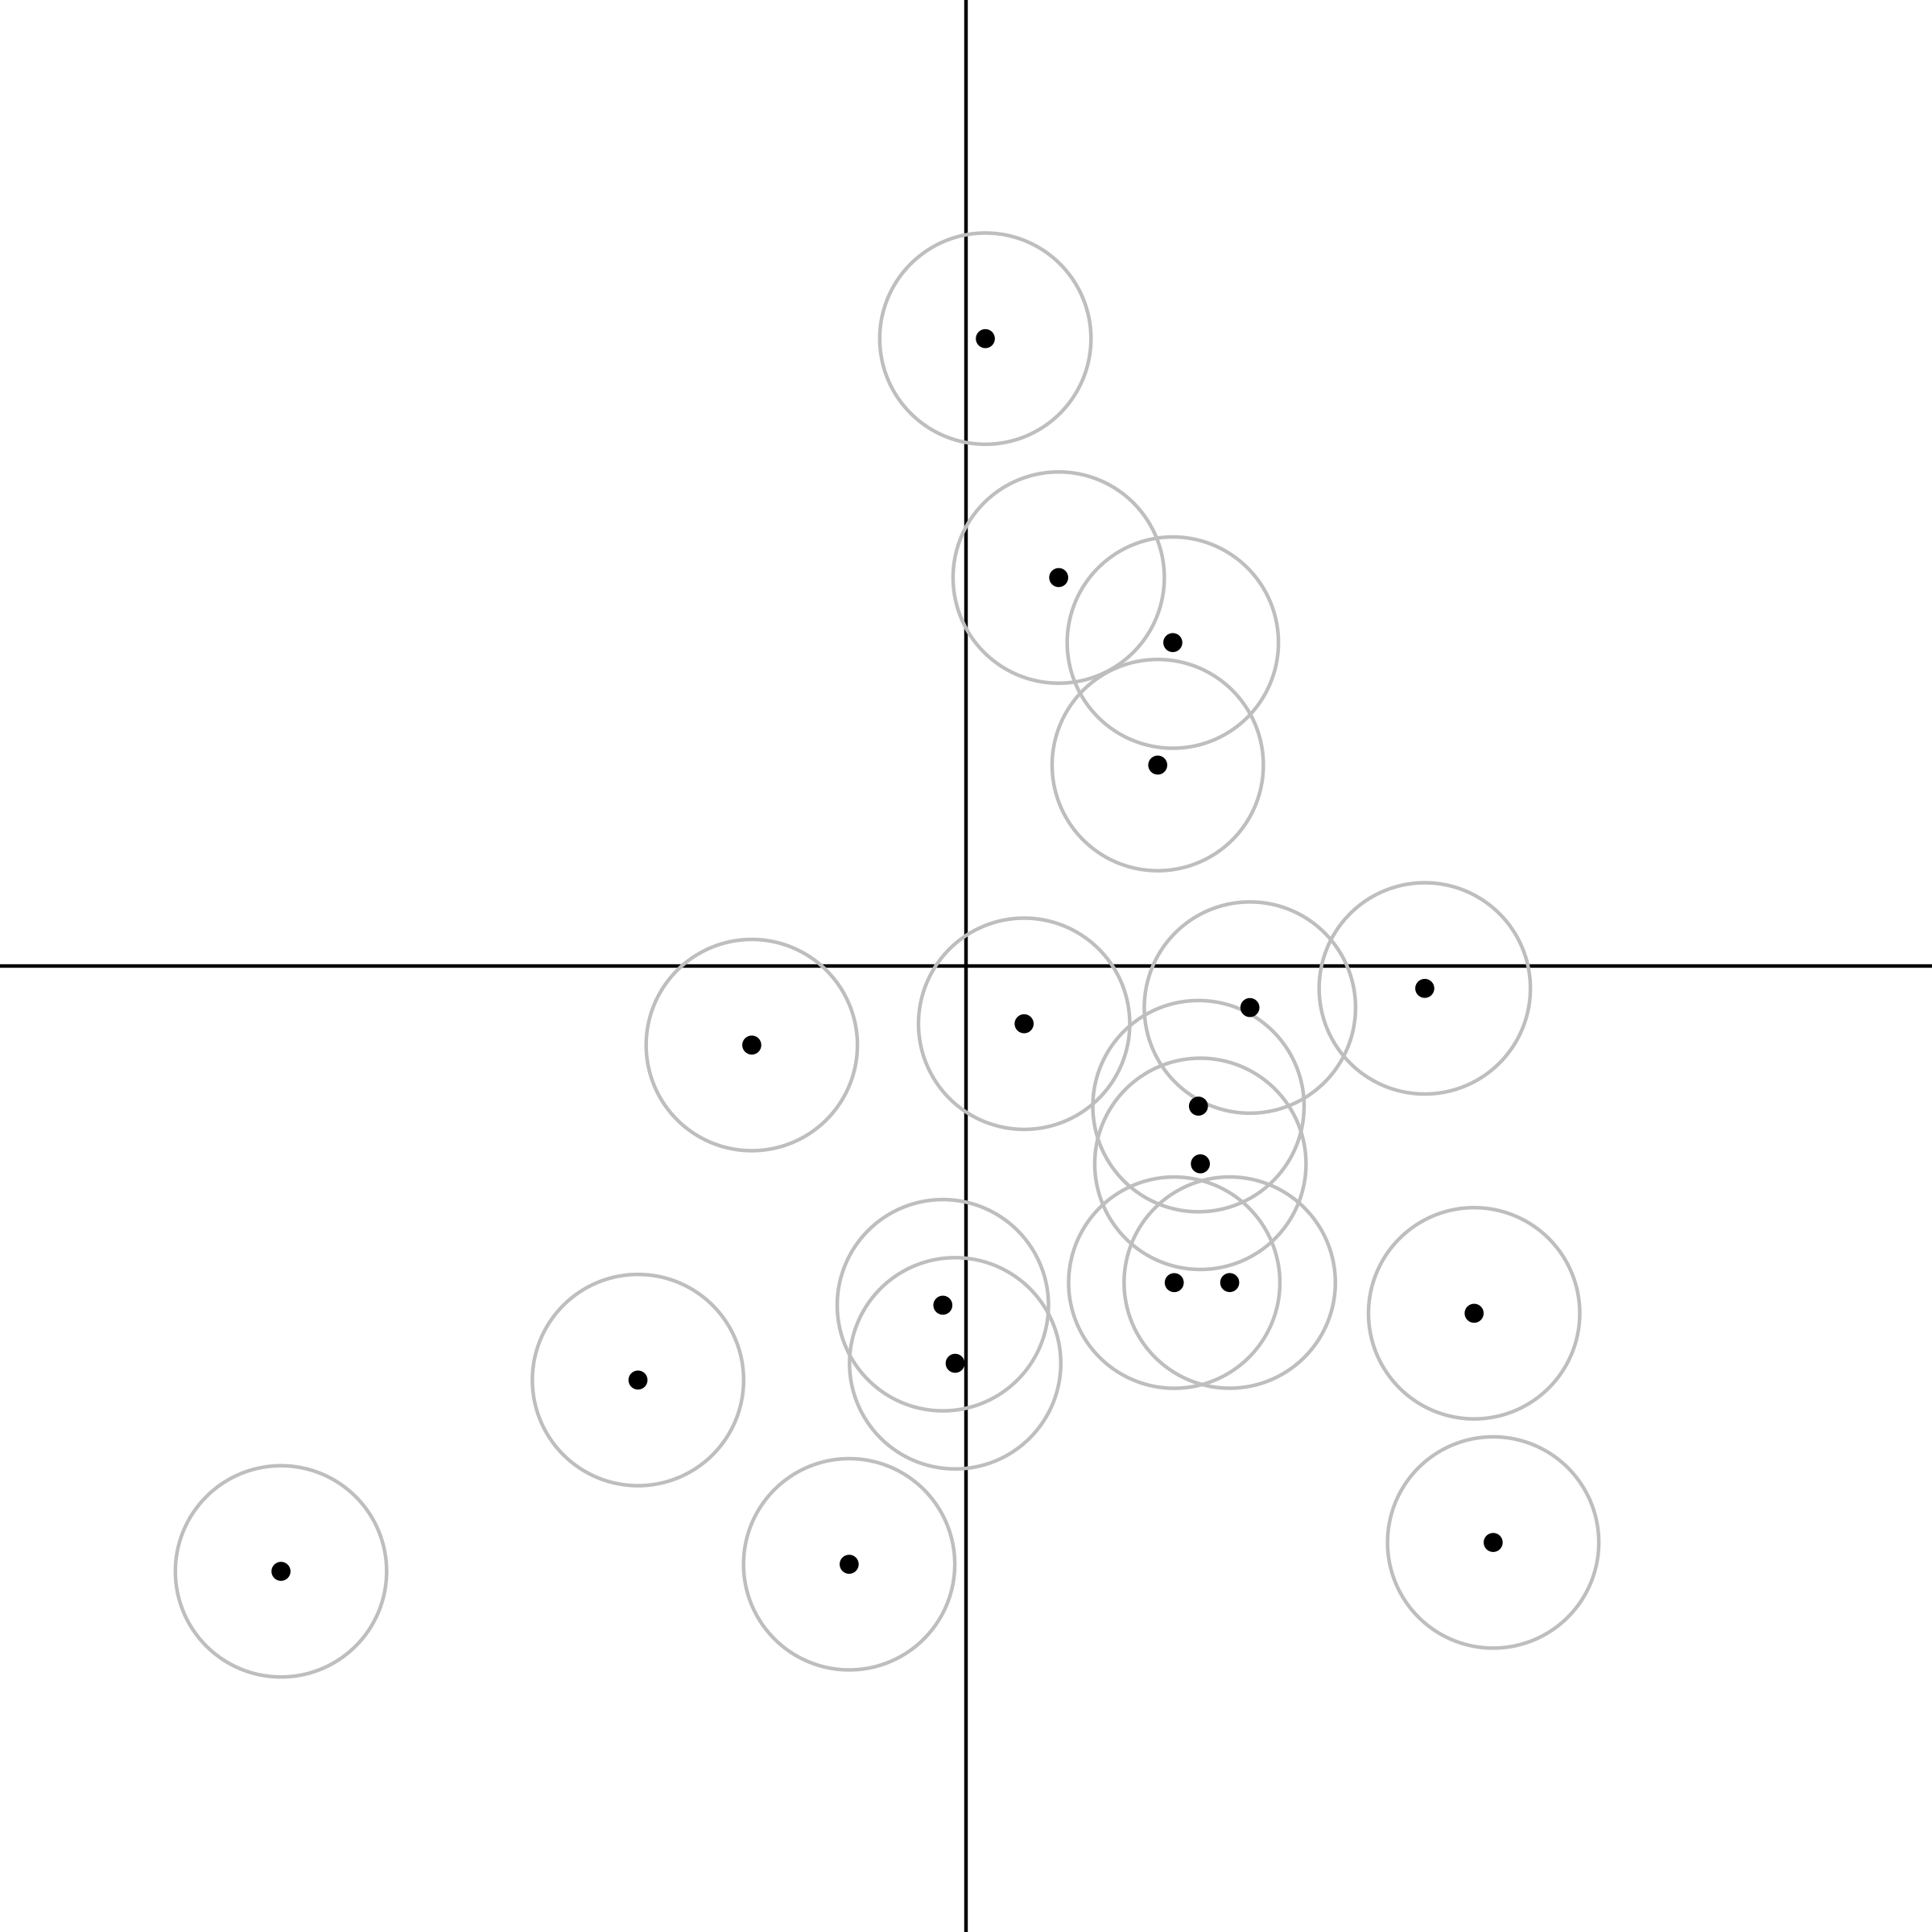
NP _ed about XP
NP _ed

Slide 168
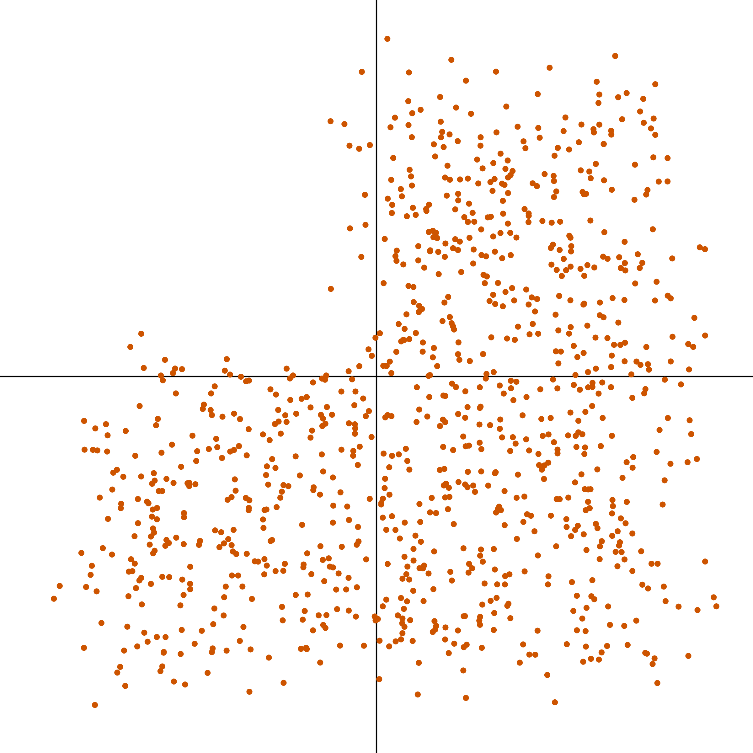
NP _ed about XP
NP _ed

Slide 169
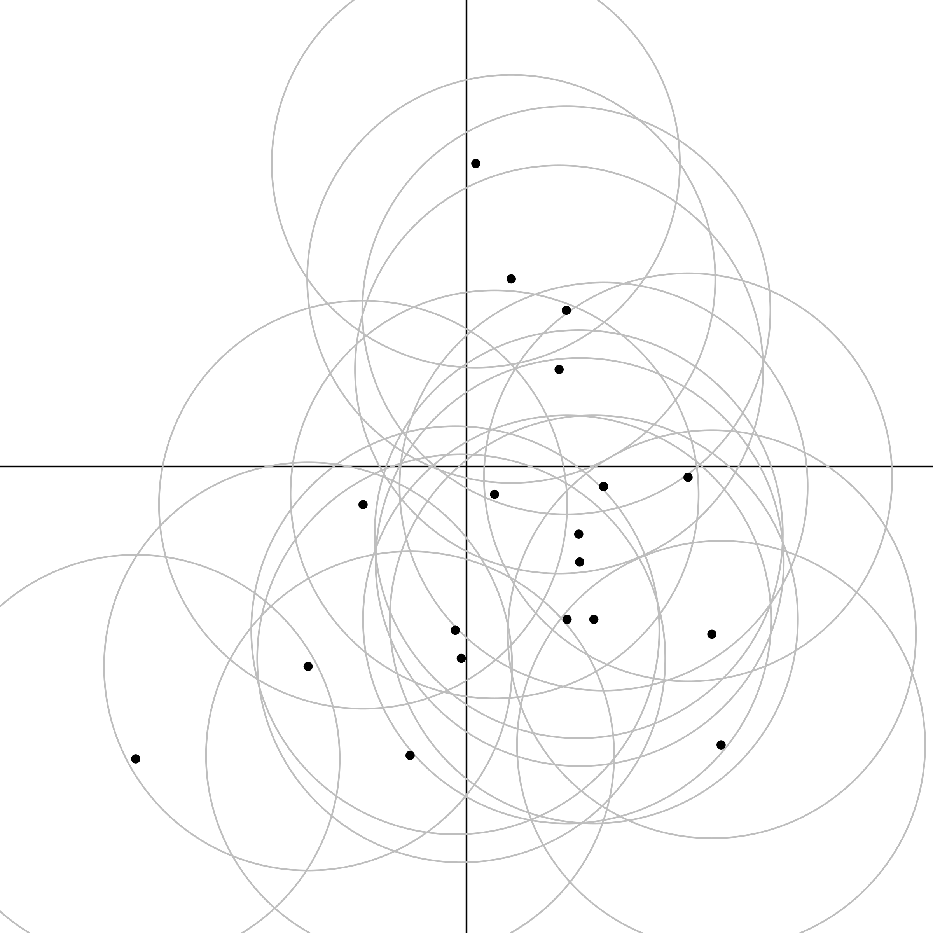
NP _ed about XP
NP _ed

Slide 170
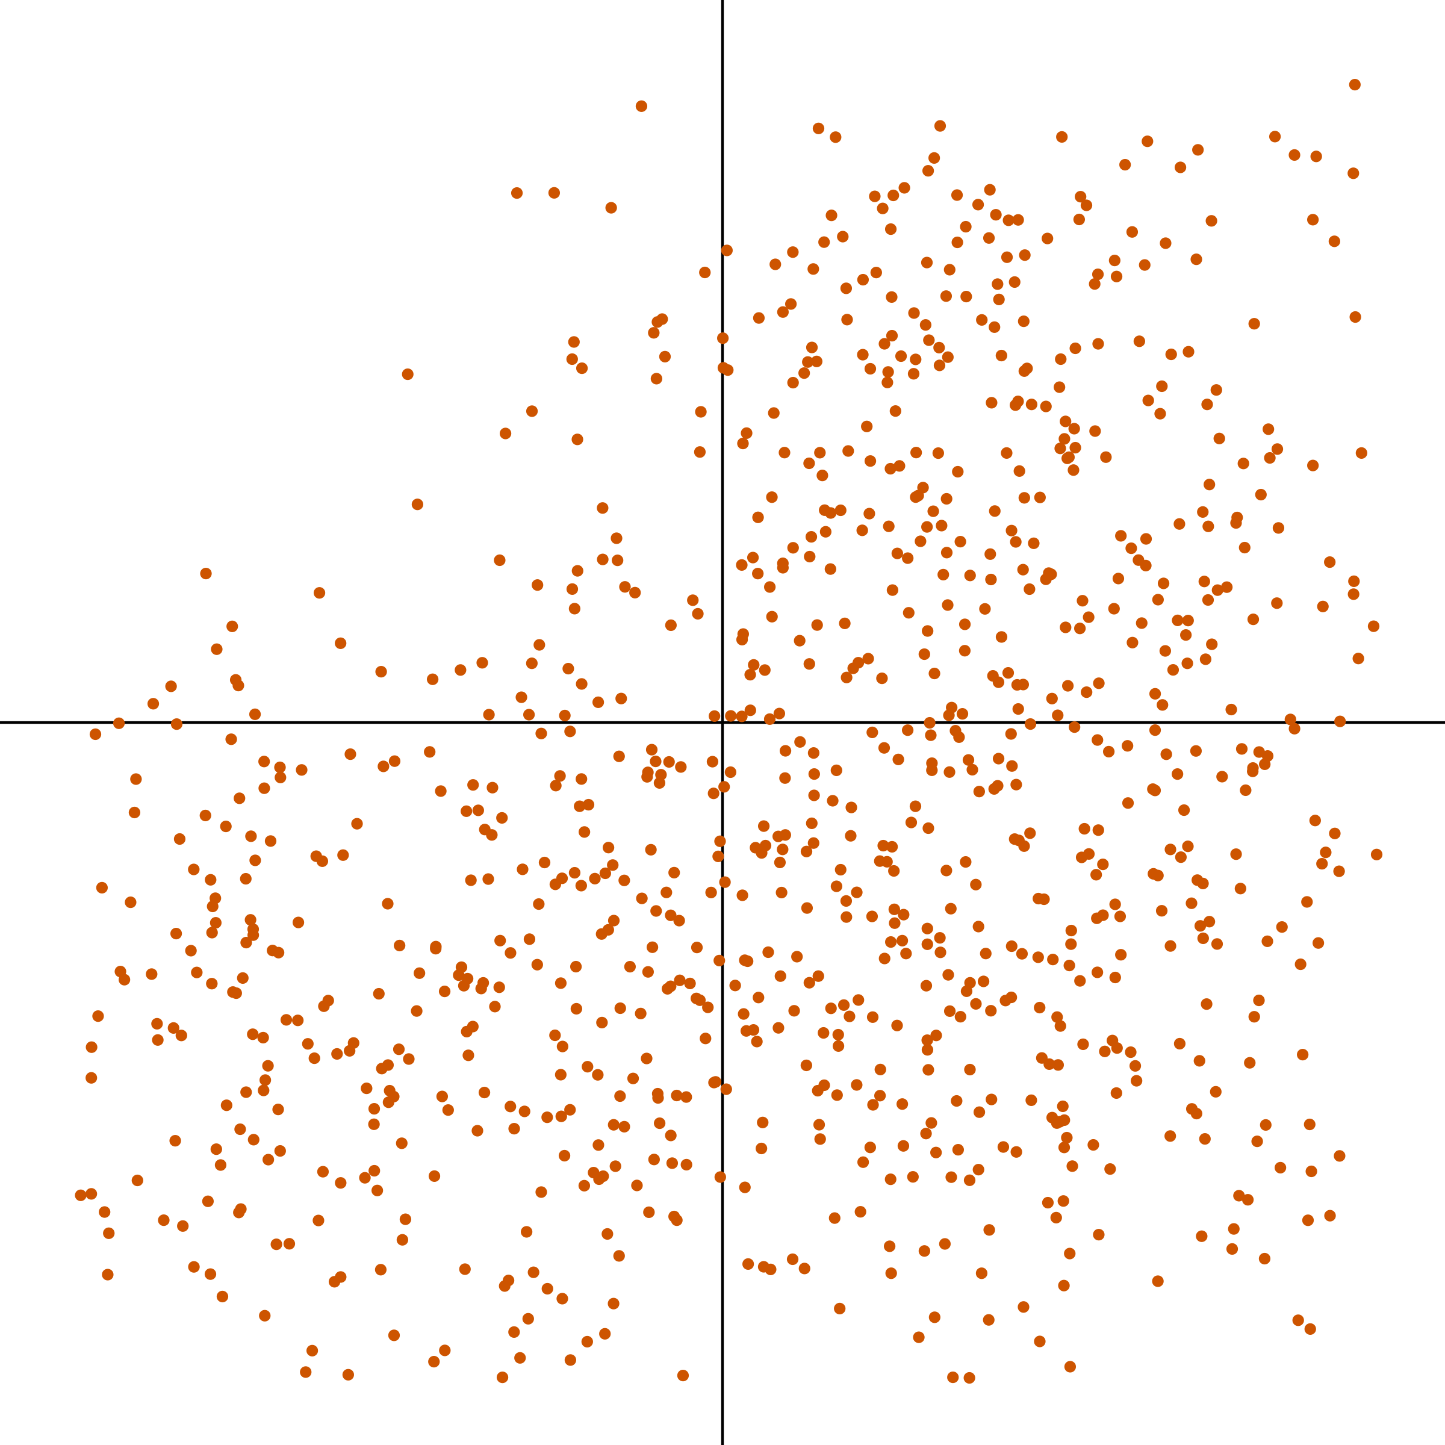
NP _ed about XP
NP _ed

Slide 171
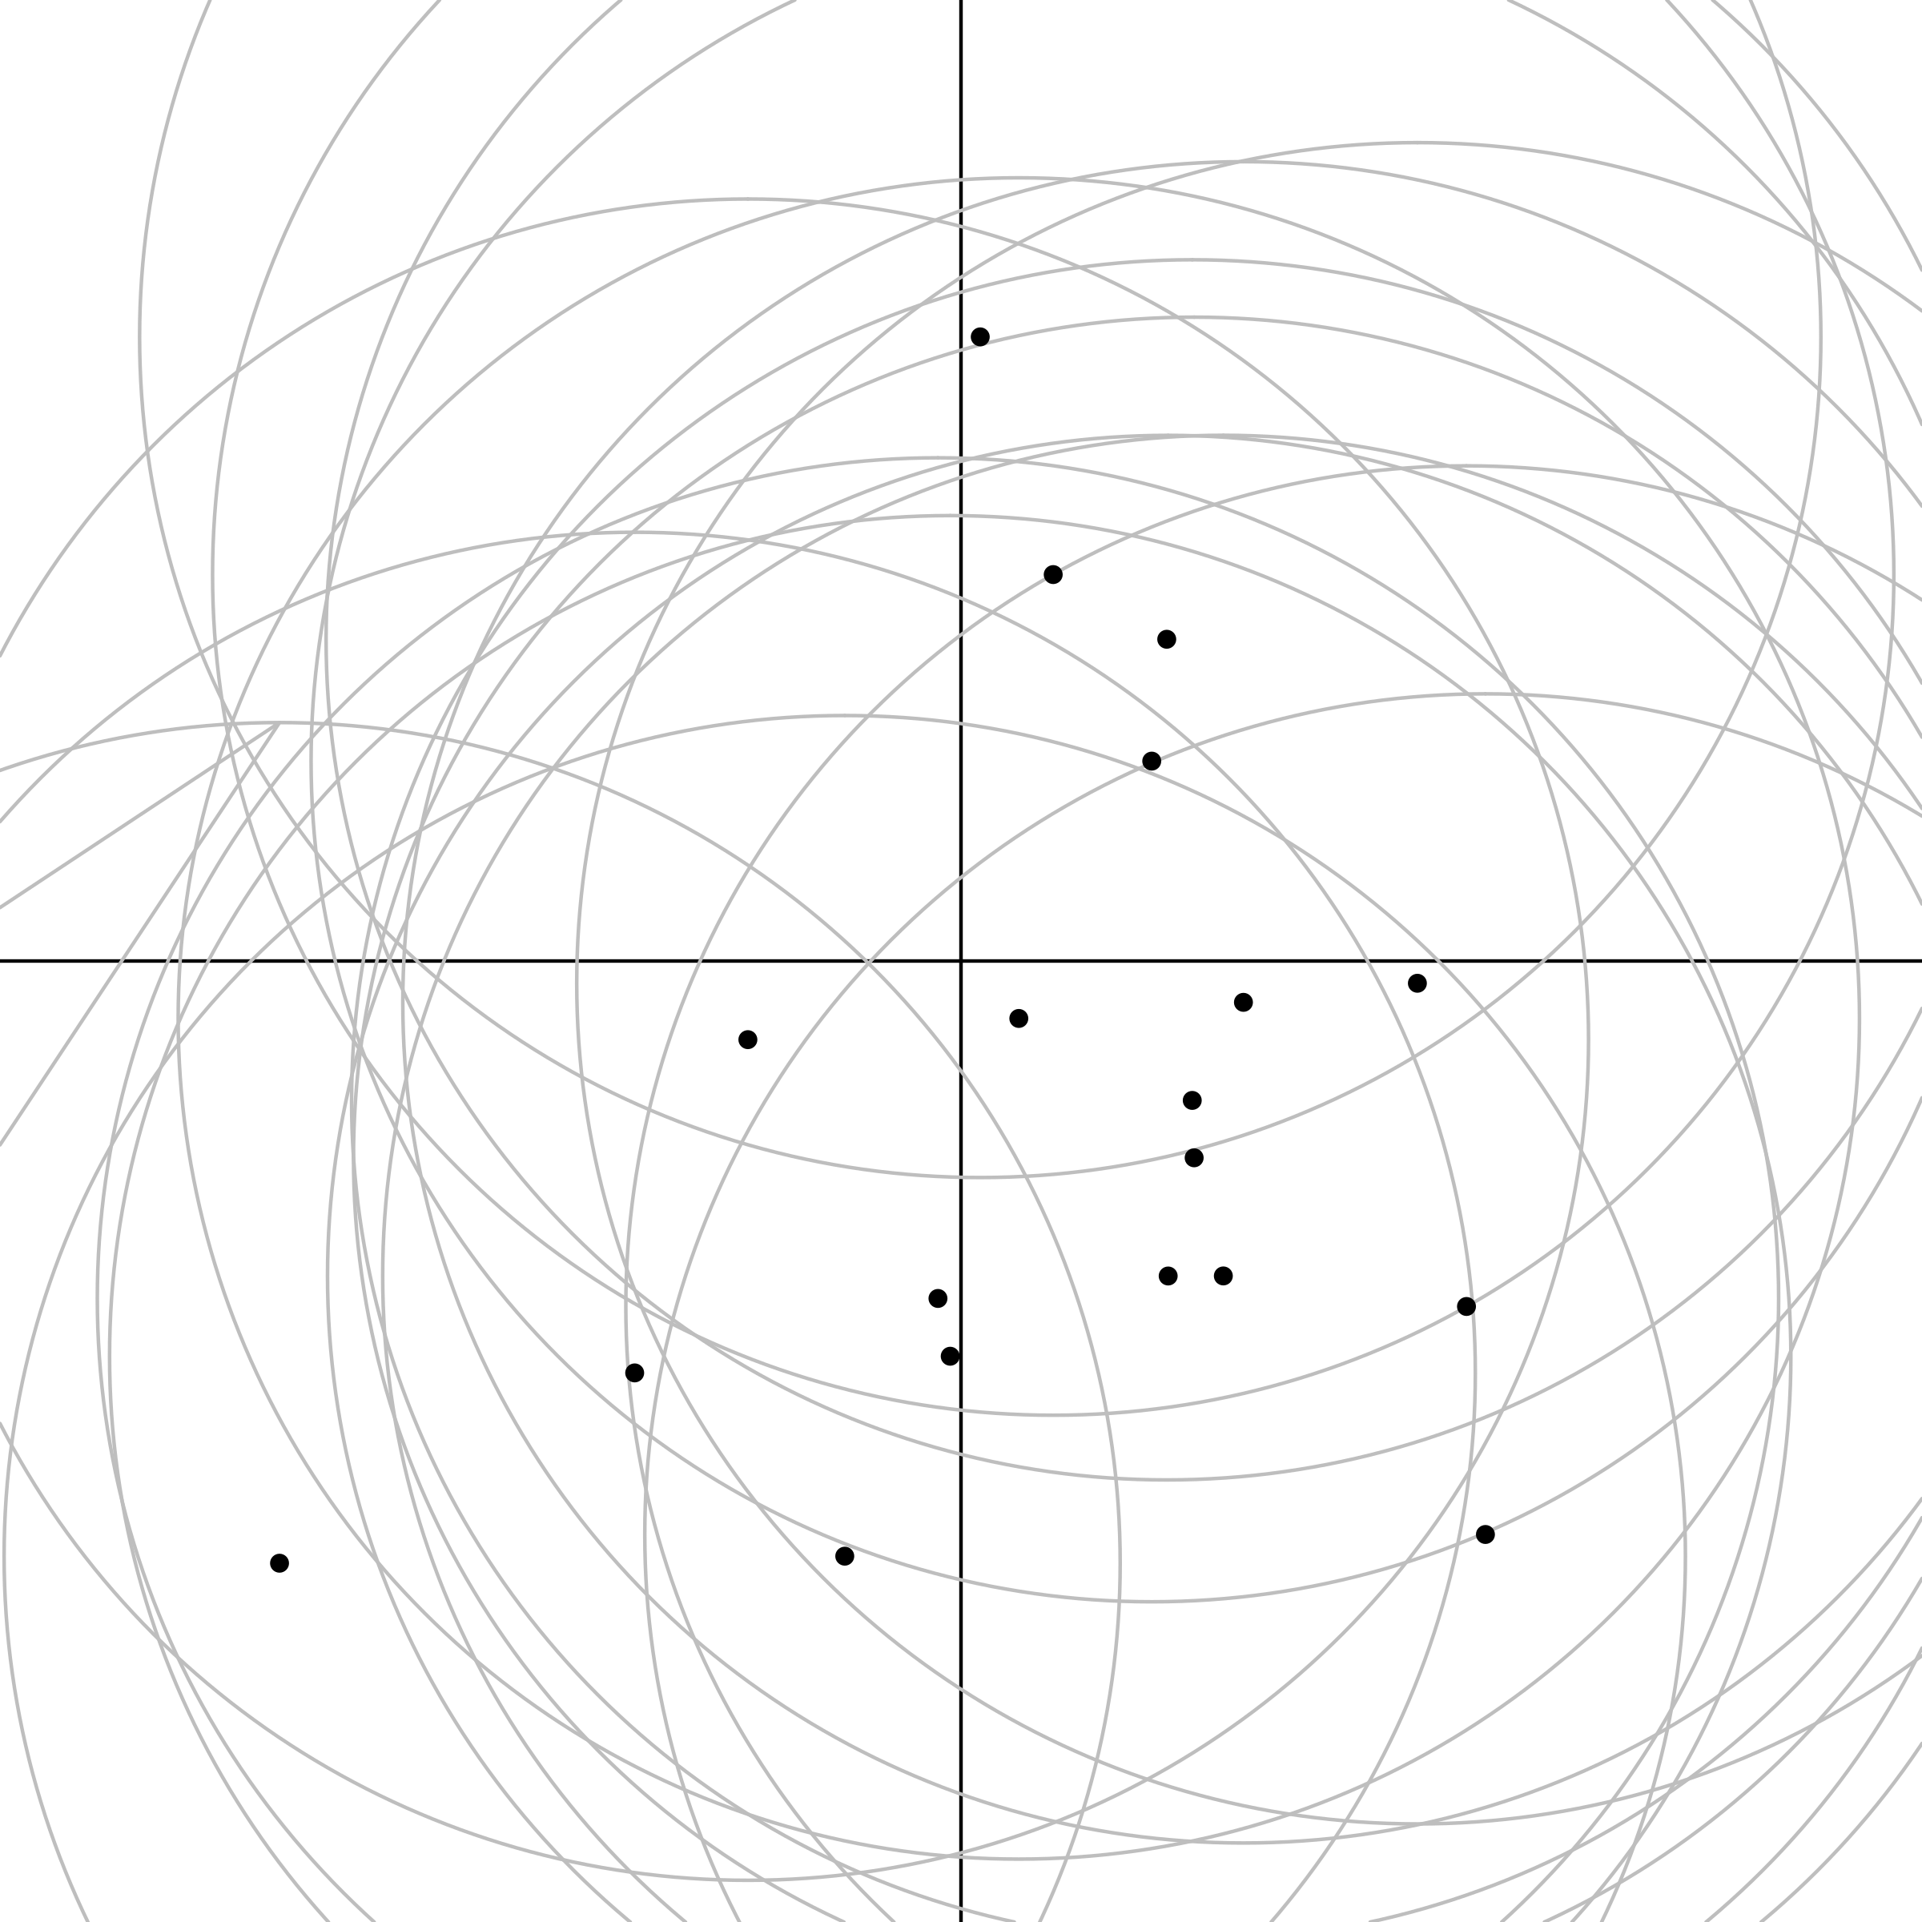
NP _ed about XP
NP _ed

Slide 172
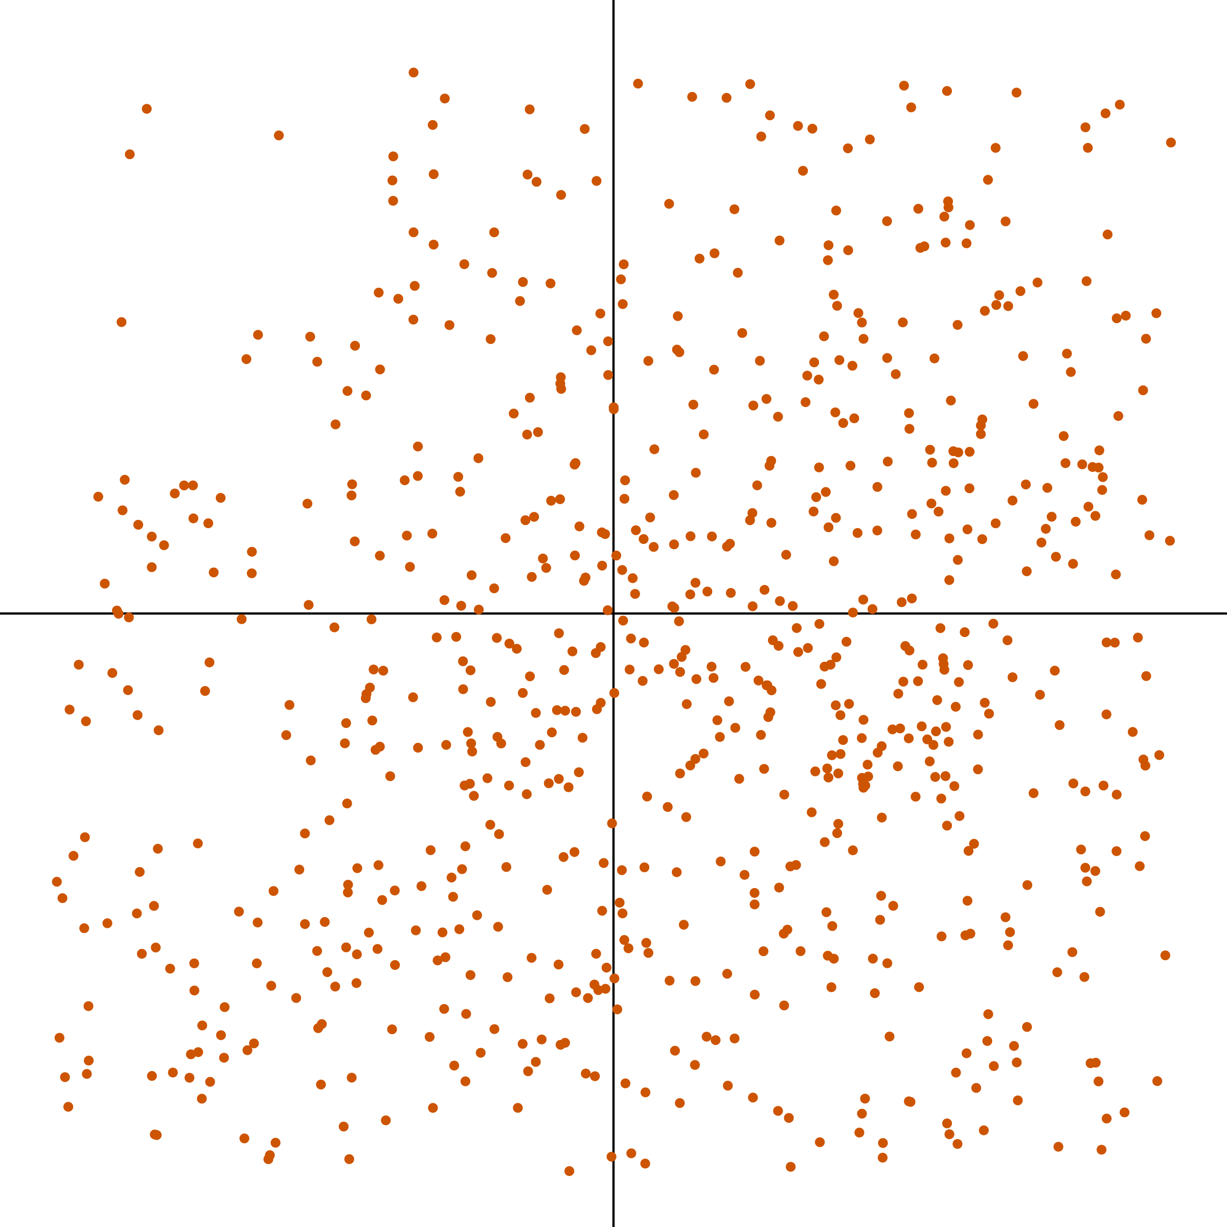
NP _ed about XP
NP _ed

Slide 173
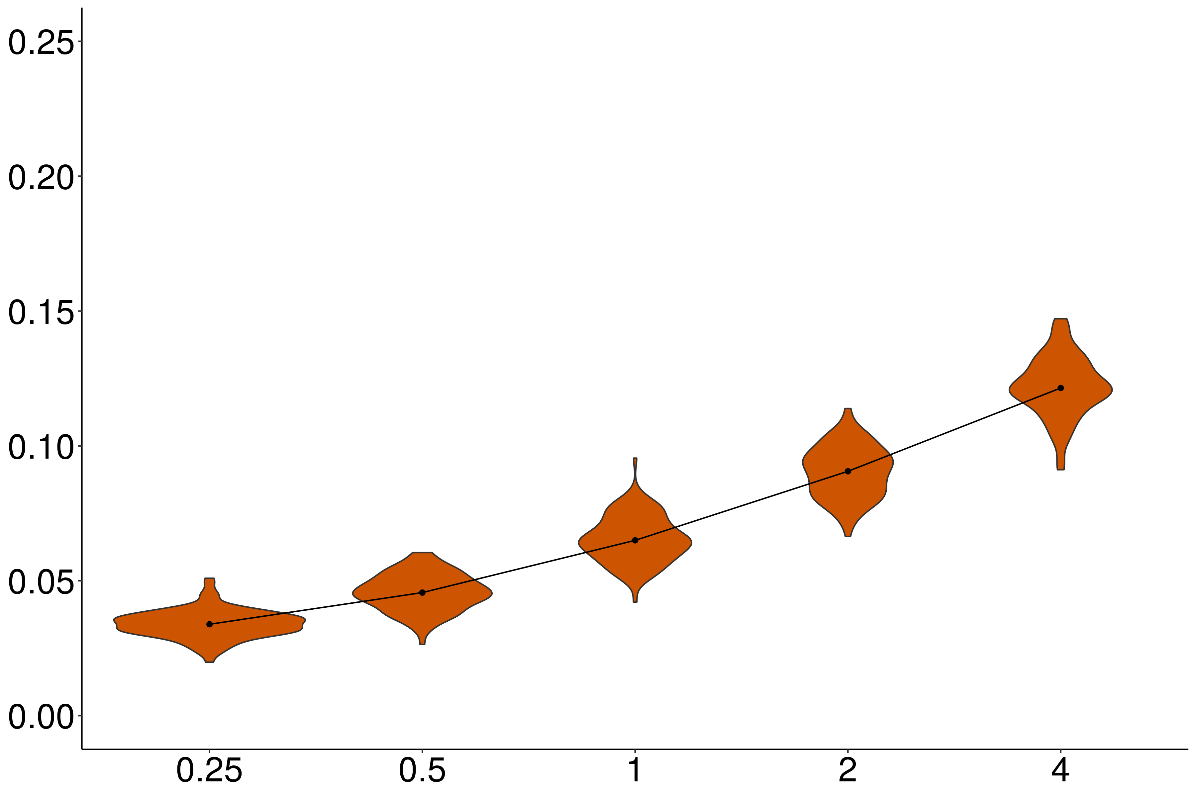
Independence
Proportion violations
Noise variance / acceptability variance

Slide 174
Independence
Proportion violations
Noise variance / acceptability variance

Slide 175
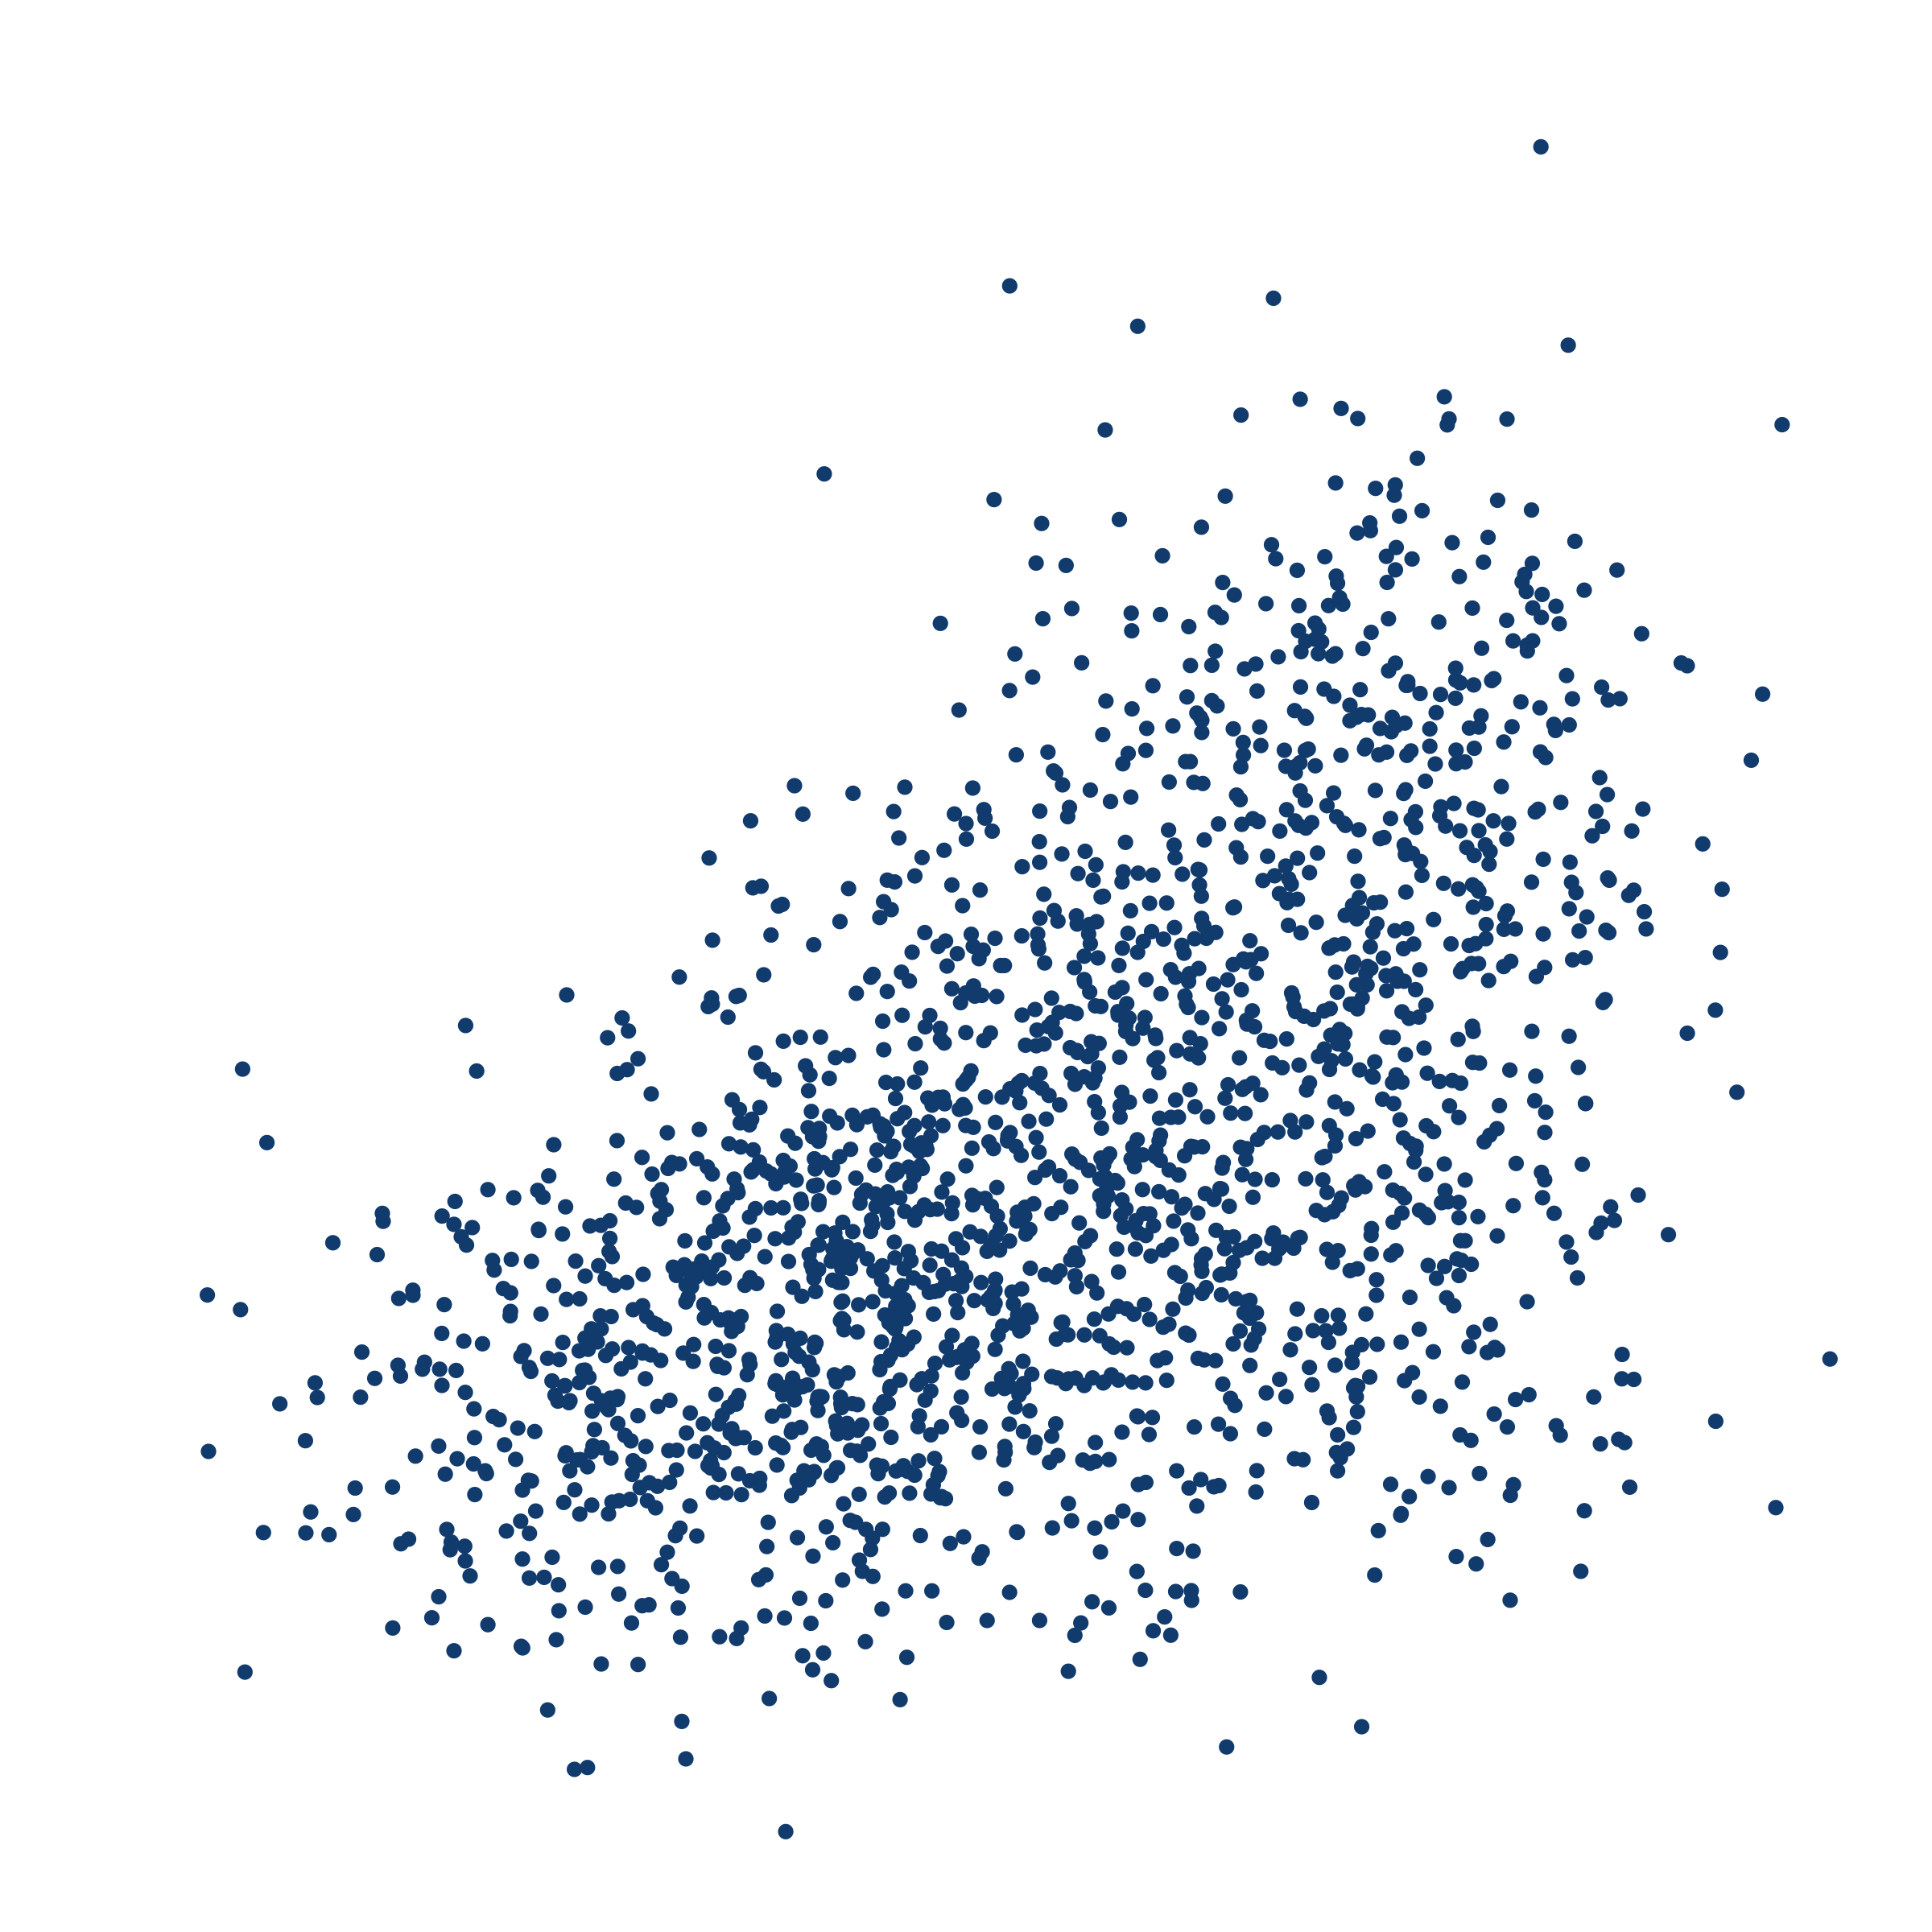
NP (was) _ed about whether S
NP (was) _ed

Slide 176
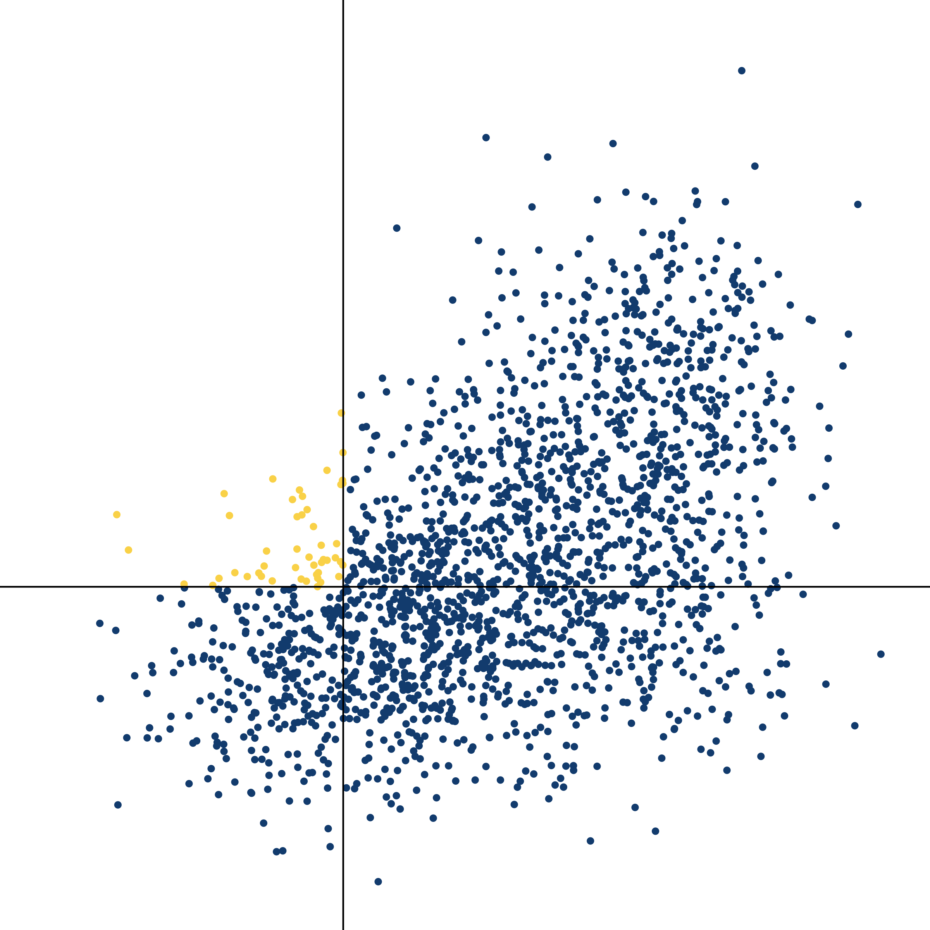
NP (was) _ed about whether S
NP (was) _ed

Slide 177
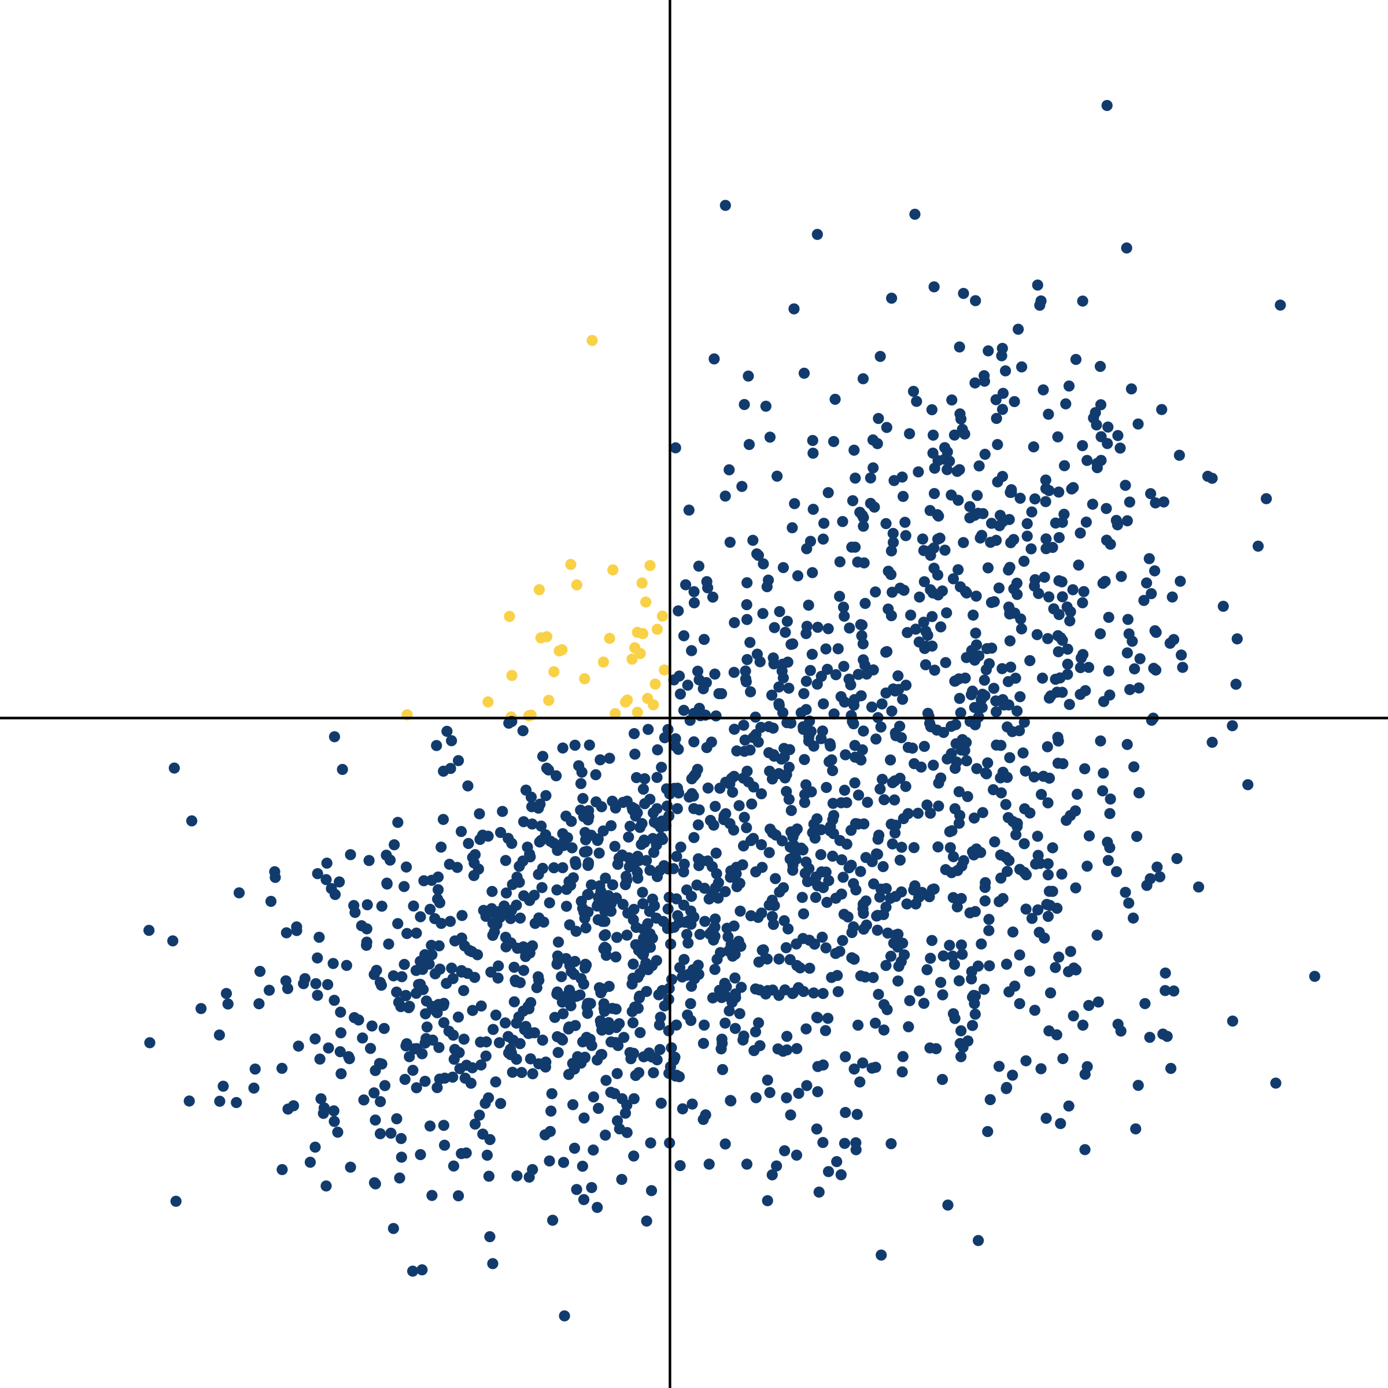
NP (was) _ed about whether S
NP (was) _ed

Slide 178
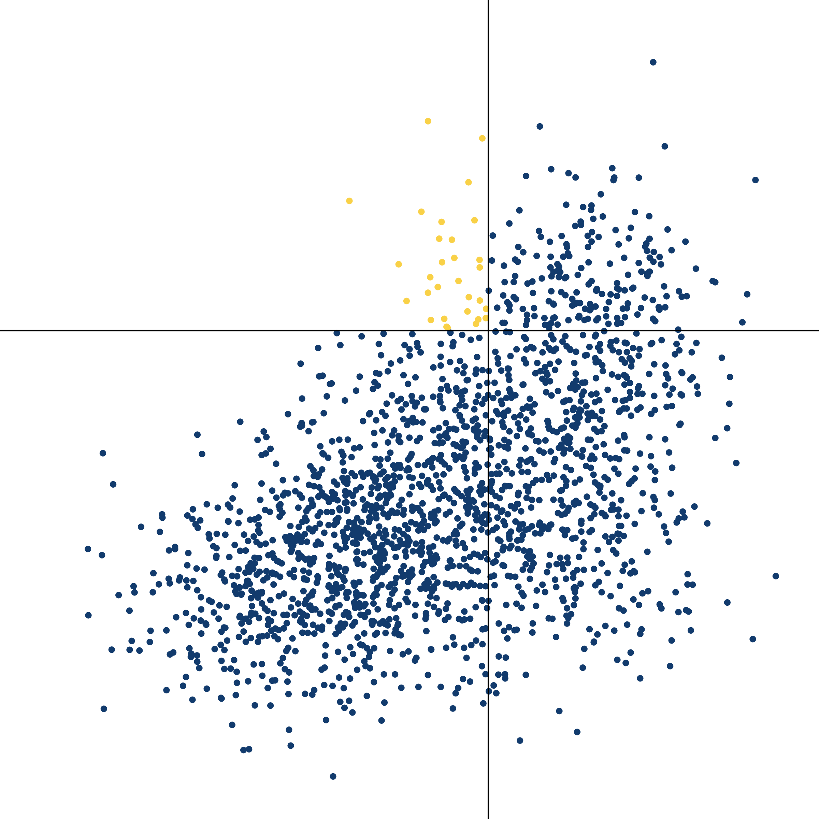
NP (was) _ed about whether S
NP (was) _ed

Slide 179
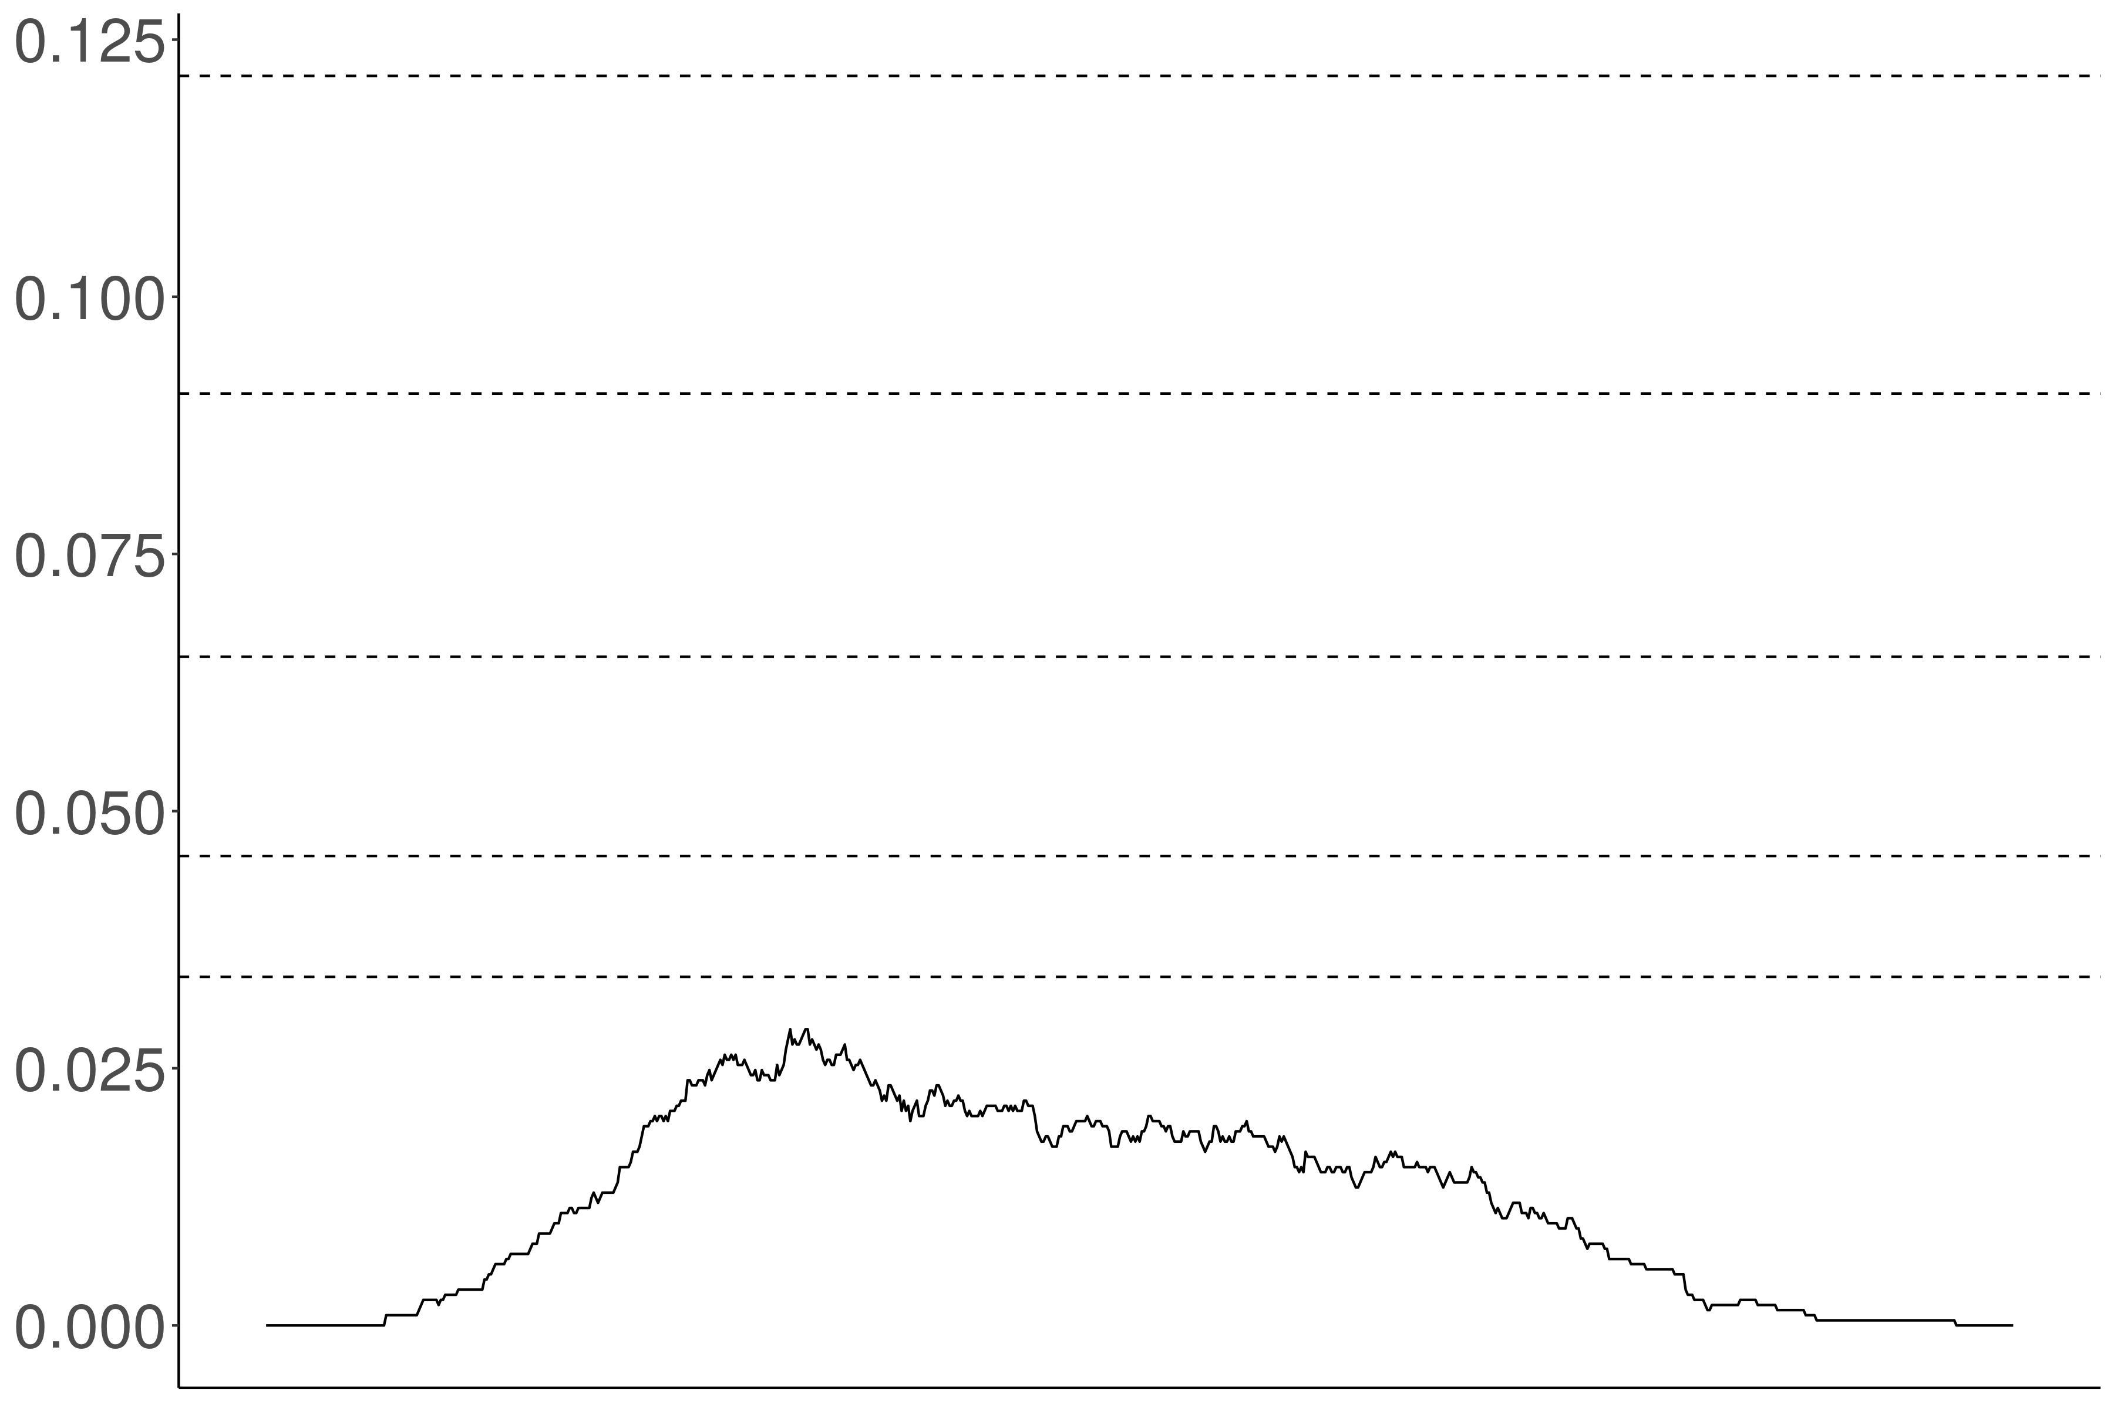
Proportion violations
Acceptability threshold

Slide 180
Independence
Proportion violations
Noise variance / acceptability variance

Slide 181
Proportion violations
Acceptability threshold

Slide 182
Proportion violations
Acceptability threshold

Slide 183
Appendix C
Inference Validation #1

Slide 184
 | Neg-raising | Non-neg-raising
NP __ that S | think, believe, feel, reckon, figure, guess, suppose, imagine | announce, claim, assert, report, know, realize, notice, find out
NP __ to VP | want, wish, happen, seem, plan, intend, mean, turn out | love, hate, need, continue, try, like, desire, decide

Slide 185
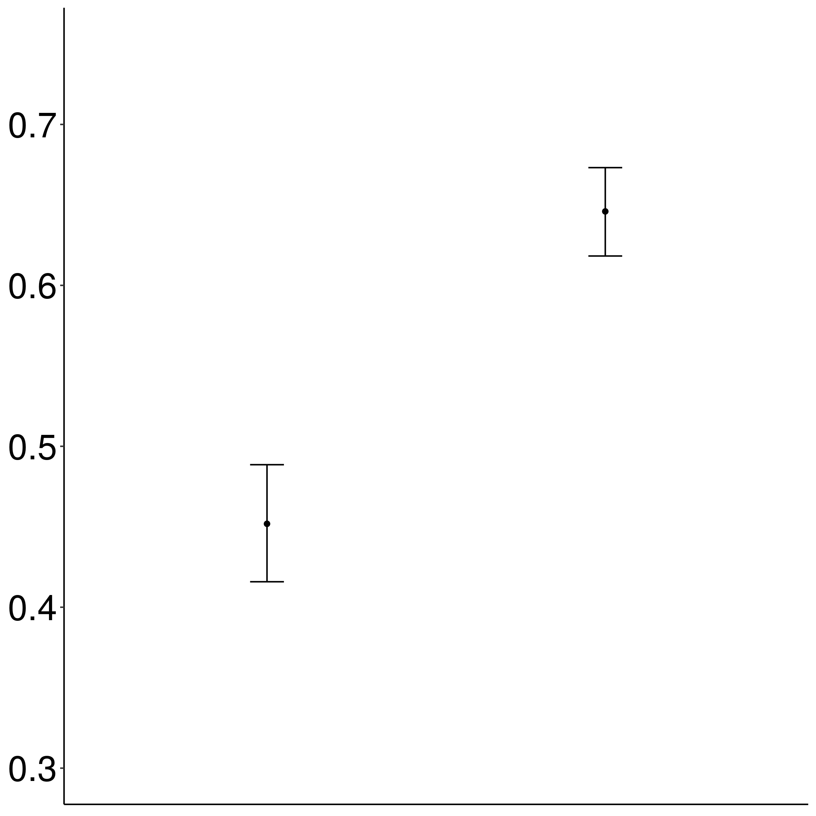
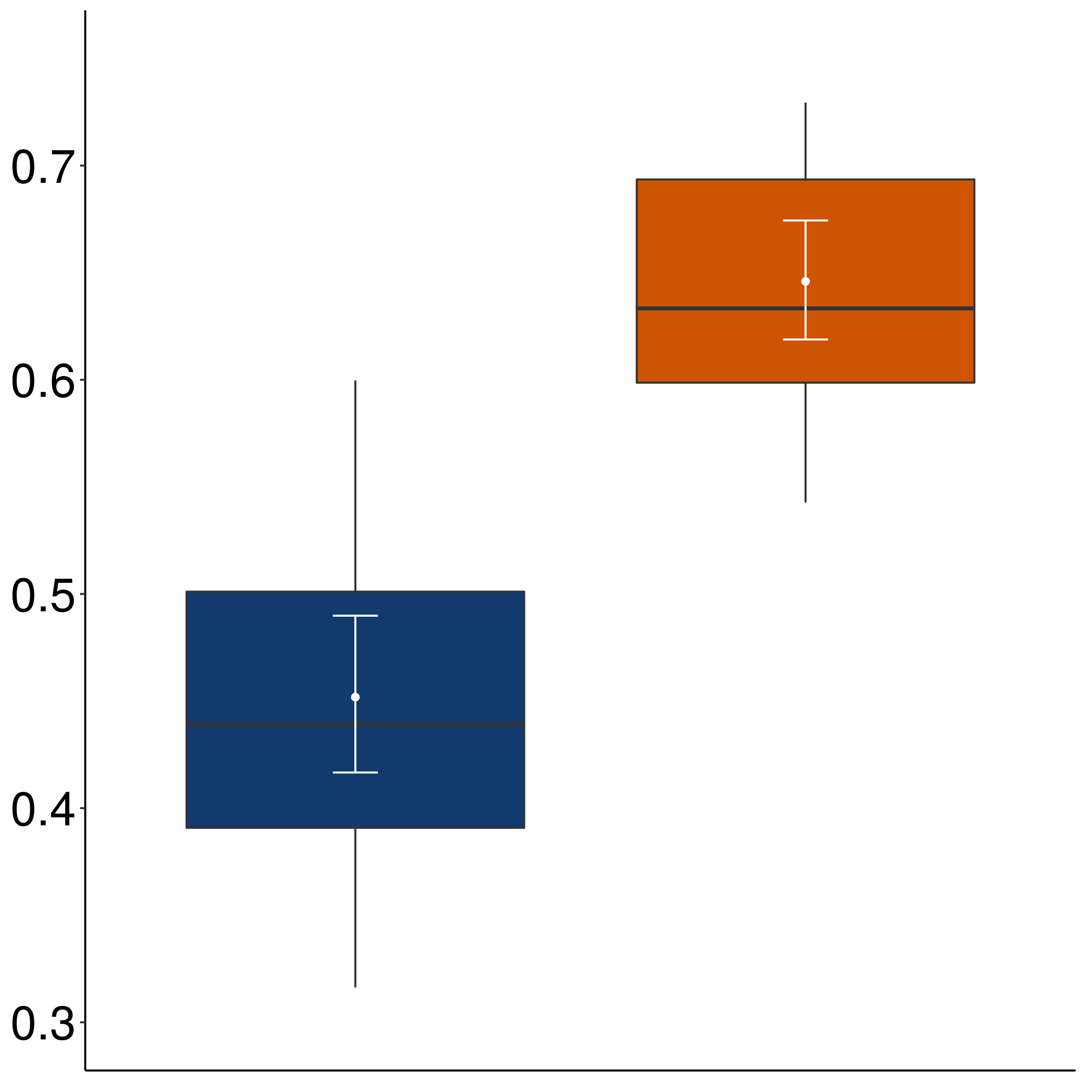
Mean rating of bleached example
Non-neg-raising
Neg-raising

Slide 186
Appendix D
Inference Validation #2

Slide 187
Implementation
For each verb-frame pair in validation set, sample five items from corpus.

Slide 188
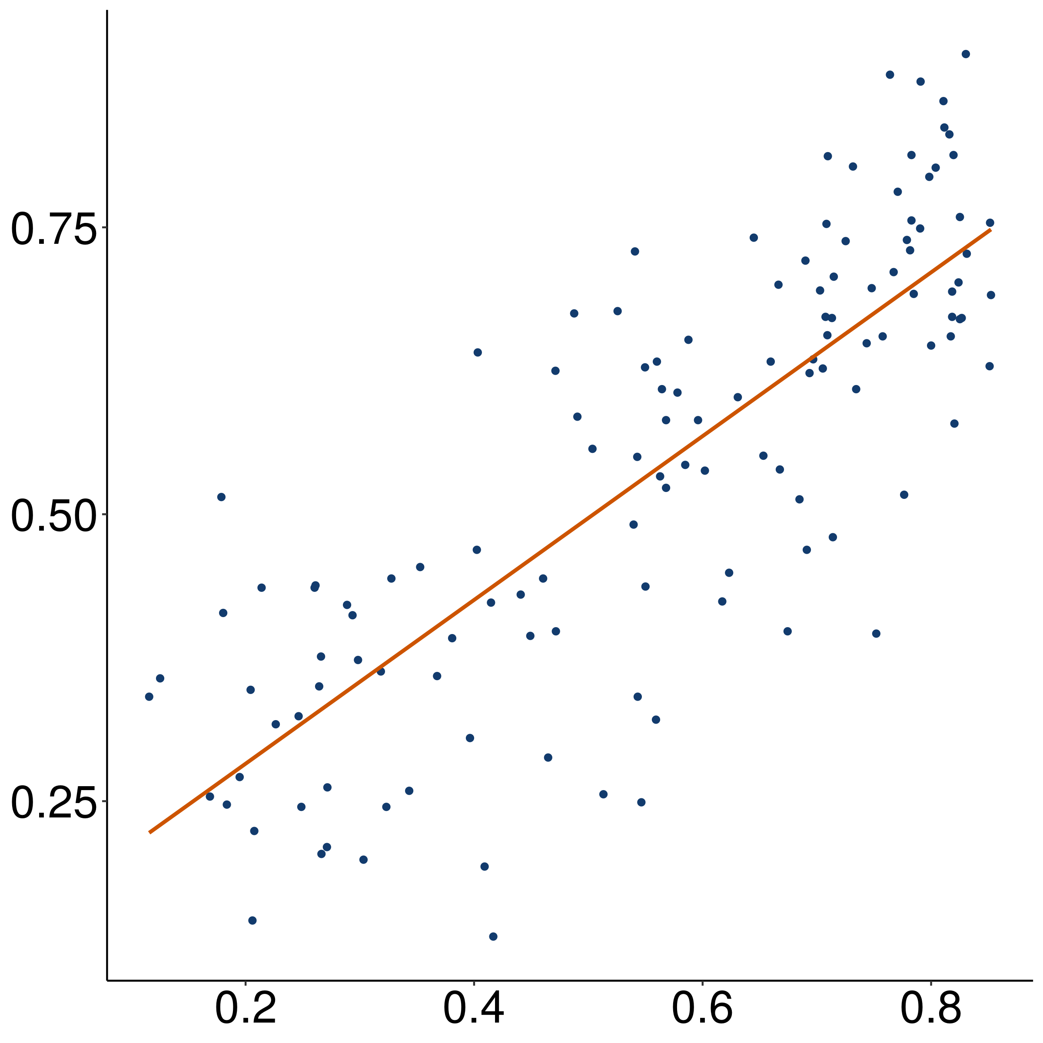
Mean rating of bleached example
r = 0.8
(p < 0.001)
Mean rating of corpus example

Slide 189
Appendix E
Inference Validation #3

Slide 190
Implementation
For each verb-frame pair in validation set, collect acceptability of strong NPI (additive either).
Jo didn’t do a particular thing, and…
…I don’t think that Bo did that thing either.
…I think that Bo didn’t do that thing either.

Slide 191
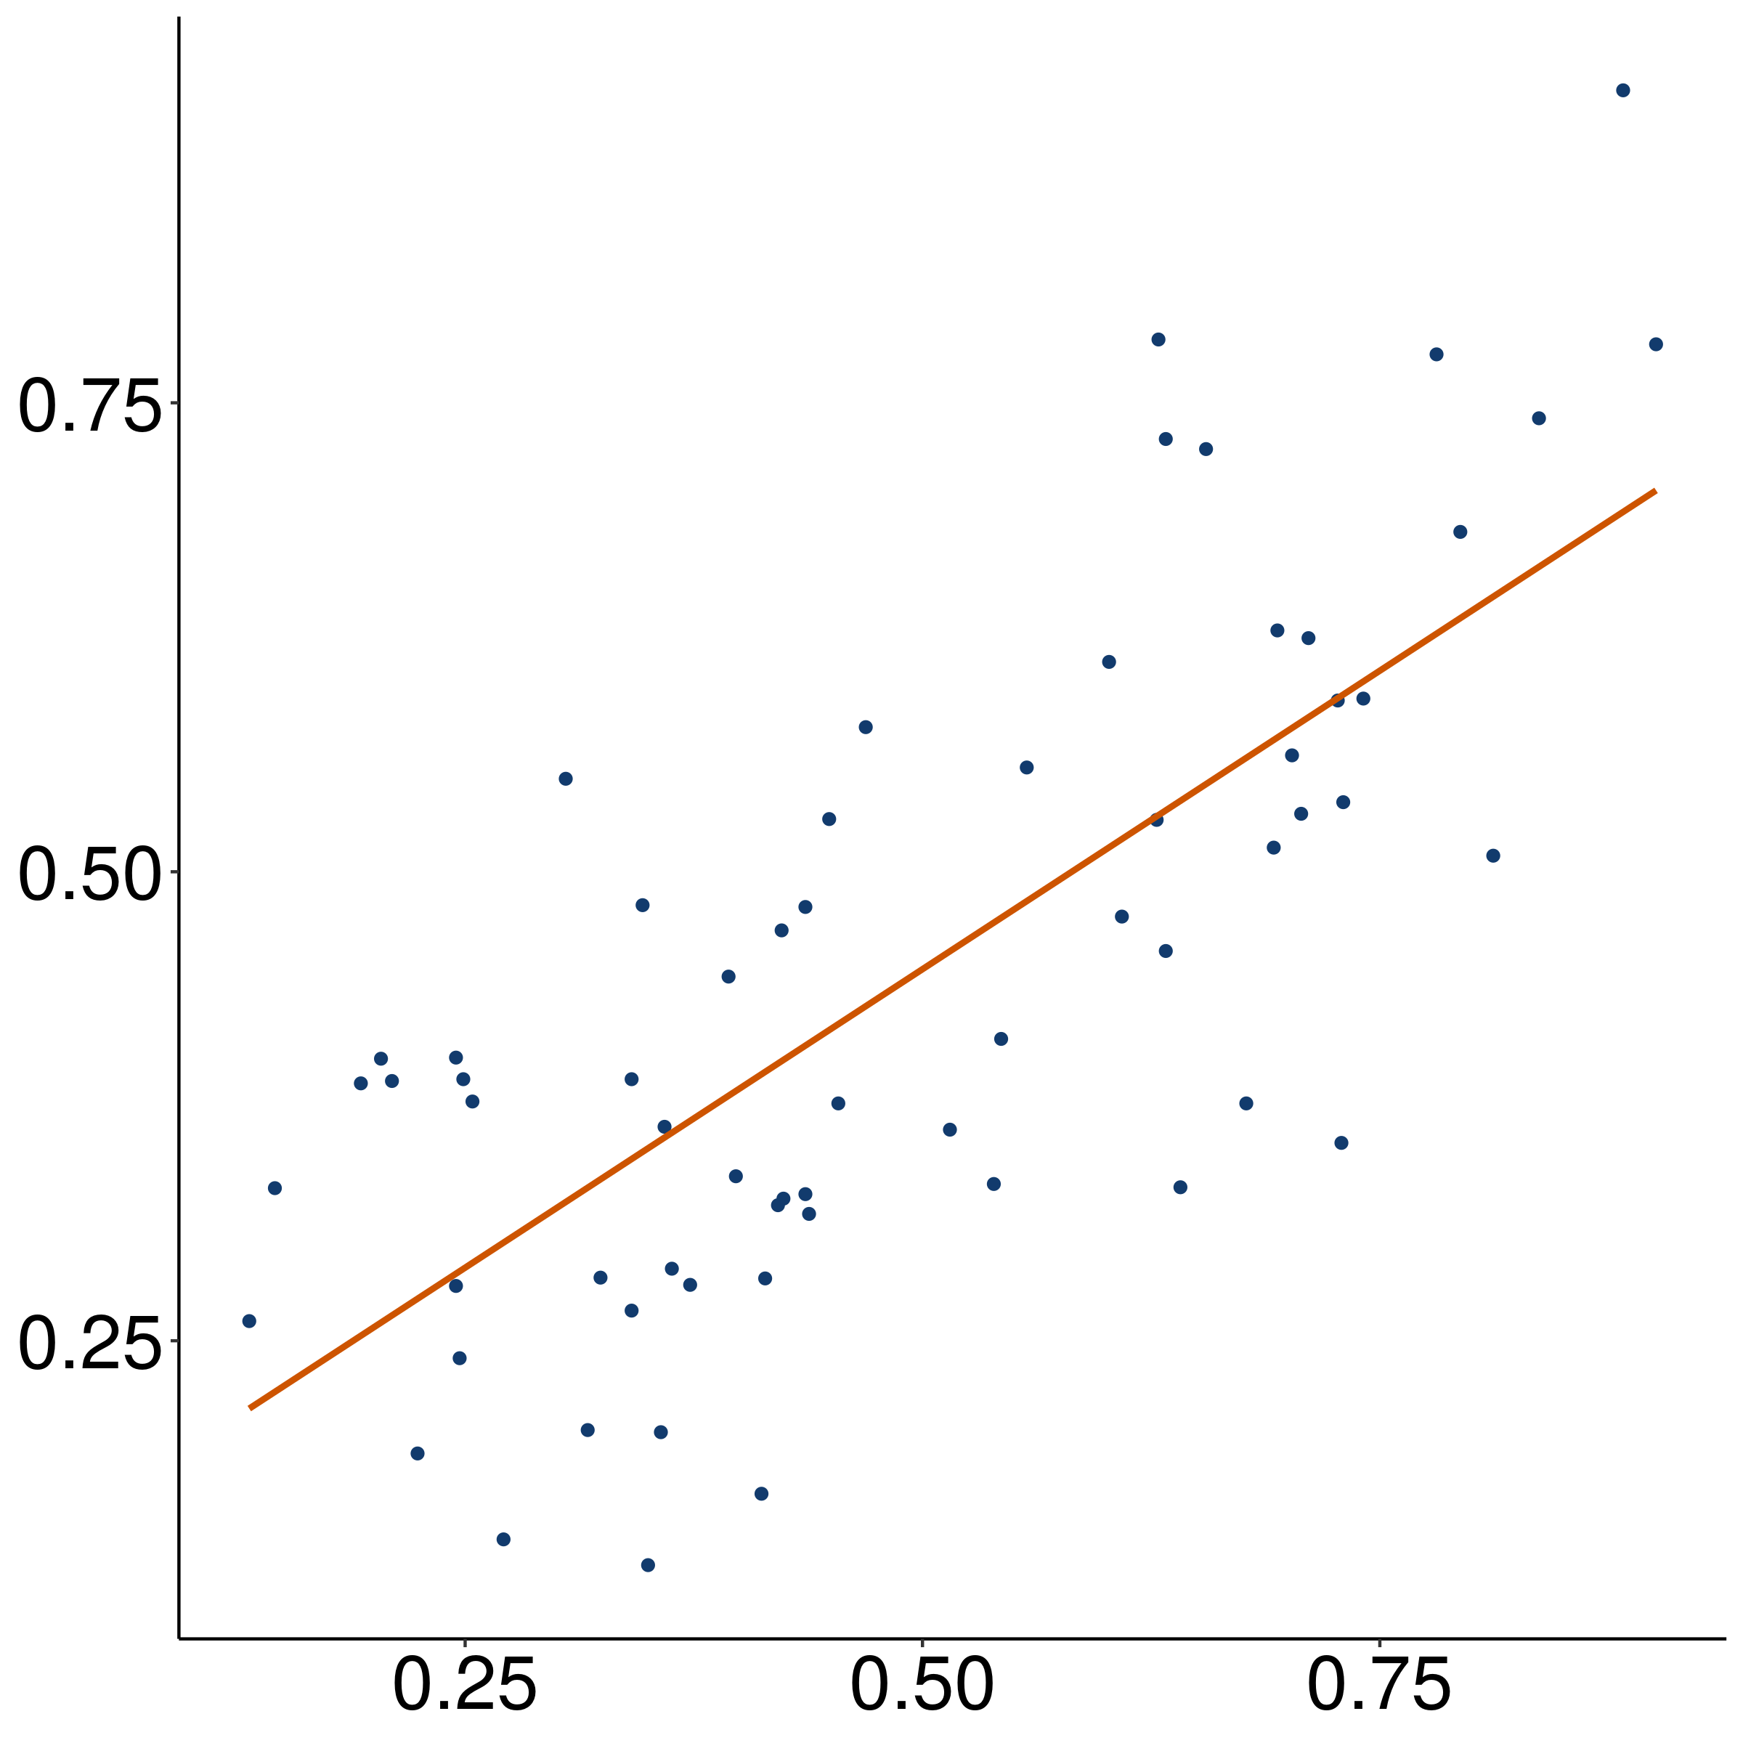
Mean acceptability of strong NPI
r = 0.77
(p < 0.001)
Mean rating of bleached example

Slide 192
Appendix F
Predicates in each class

Slide 193
glare, grin, strut, talk, beam, frown, scowl, sulk, …

Slide 194
hound, pester, educate, interview, badger, brief, bug, challenge, …

Slide 195
bury, come, function, happen, invite, result, …

Slide 196
inform, remind, tell, advise, alert, ask, email, notify, warn, …

Slide 197
audit, discipline, approach, chastise, compliment, praise, demean, …

Slide 198
be fazed, be clouded, be gladdened, be affronted, be bored, be blessed, chide, …

Slide 199
defend, imitate, portray, address, conceal, depict, describe, detail, …

Slide 200
buy, delete, alter, attempt, insert, operate, cause, …

Slide 201
coerce, enlist, manipulate, allow, assign, bribe, coax, compel, force, …

Slide 202
articulate, communicate, explain, write, …

Slide 203
affirm, confirm, verify, acknowledge, clarify, …

Slide 204
be contented, be relieved, be amused, be charmed, be pleased, be comforted, …

Slide 205
check, investigate, contemplate, evaluate, examine, explore, …

Slide 206
aim, appear, compete, hunger, try, lust, attempt, start, …

Slide 207
expect, authorize, desire, request, allow, approve, …

Slide 208
dream, hope, think, agree, assume, …

Slide 209
discover, realize, recognize, know, find out, understand, …

Slide 210
manage, glean, opt, presuppose, signify, conclude, …

Slide 211
apologize, complain, cry, gloat, growl, sob, weep, …

Slide 212
(be) depress(ed), (be) disappoint(ed), (be) shock(ed), (be) disgust(ed), (be) displease(ed), (be) embarrass(ed), (be) frustrate(ed), (be) surprise(ed), …

Slide 213
confuse, distress, freak out, panic, perplex, puzzle, stump, baffle, …

Slide 214
fret, lie, agonize, bitch, brood, object, quarrel, quibble, whine, …

Slide 215
decline, fail, hate, neglect, refuse, regret, detest, dislike, …

Slide 216
denounce, disallow, face, prohibit, repress, abhor, admonish, …

Slide 217
doubt, question, dispute, fear, neglect, worry, …

Slide 218
Appendix G
Class-frame relationship

Slide 219
Simple past matrix

Slide 220
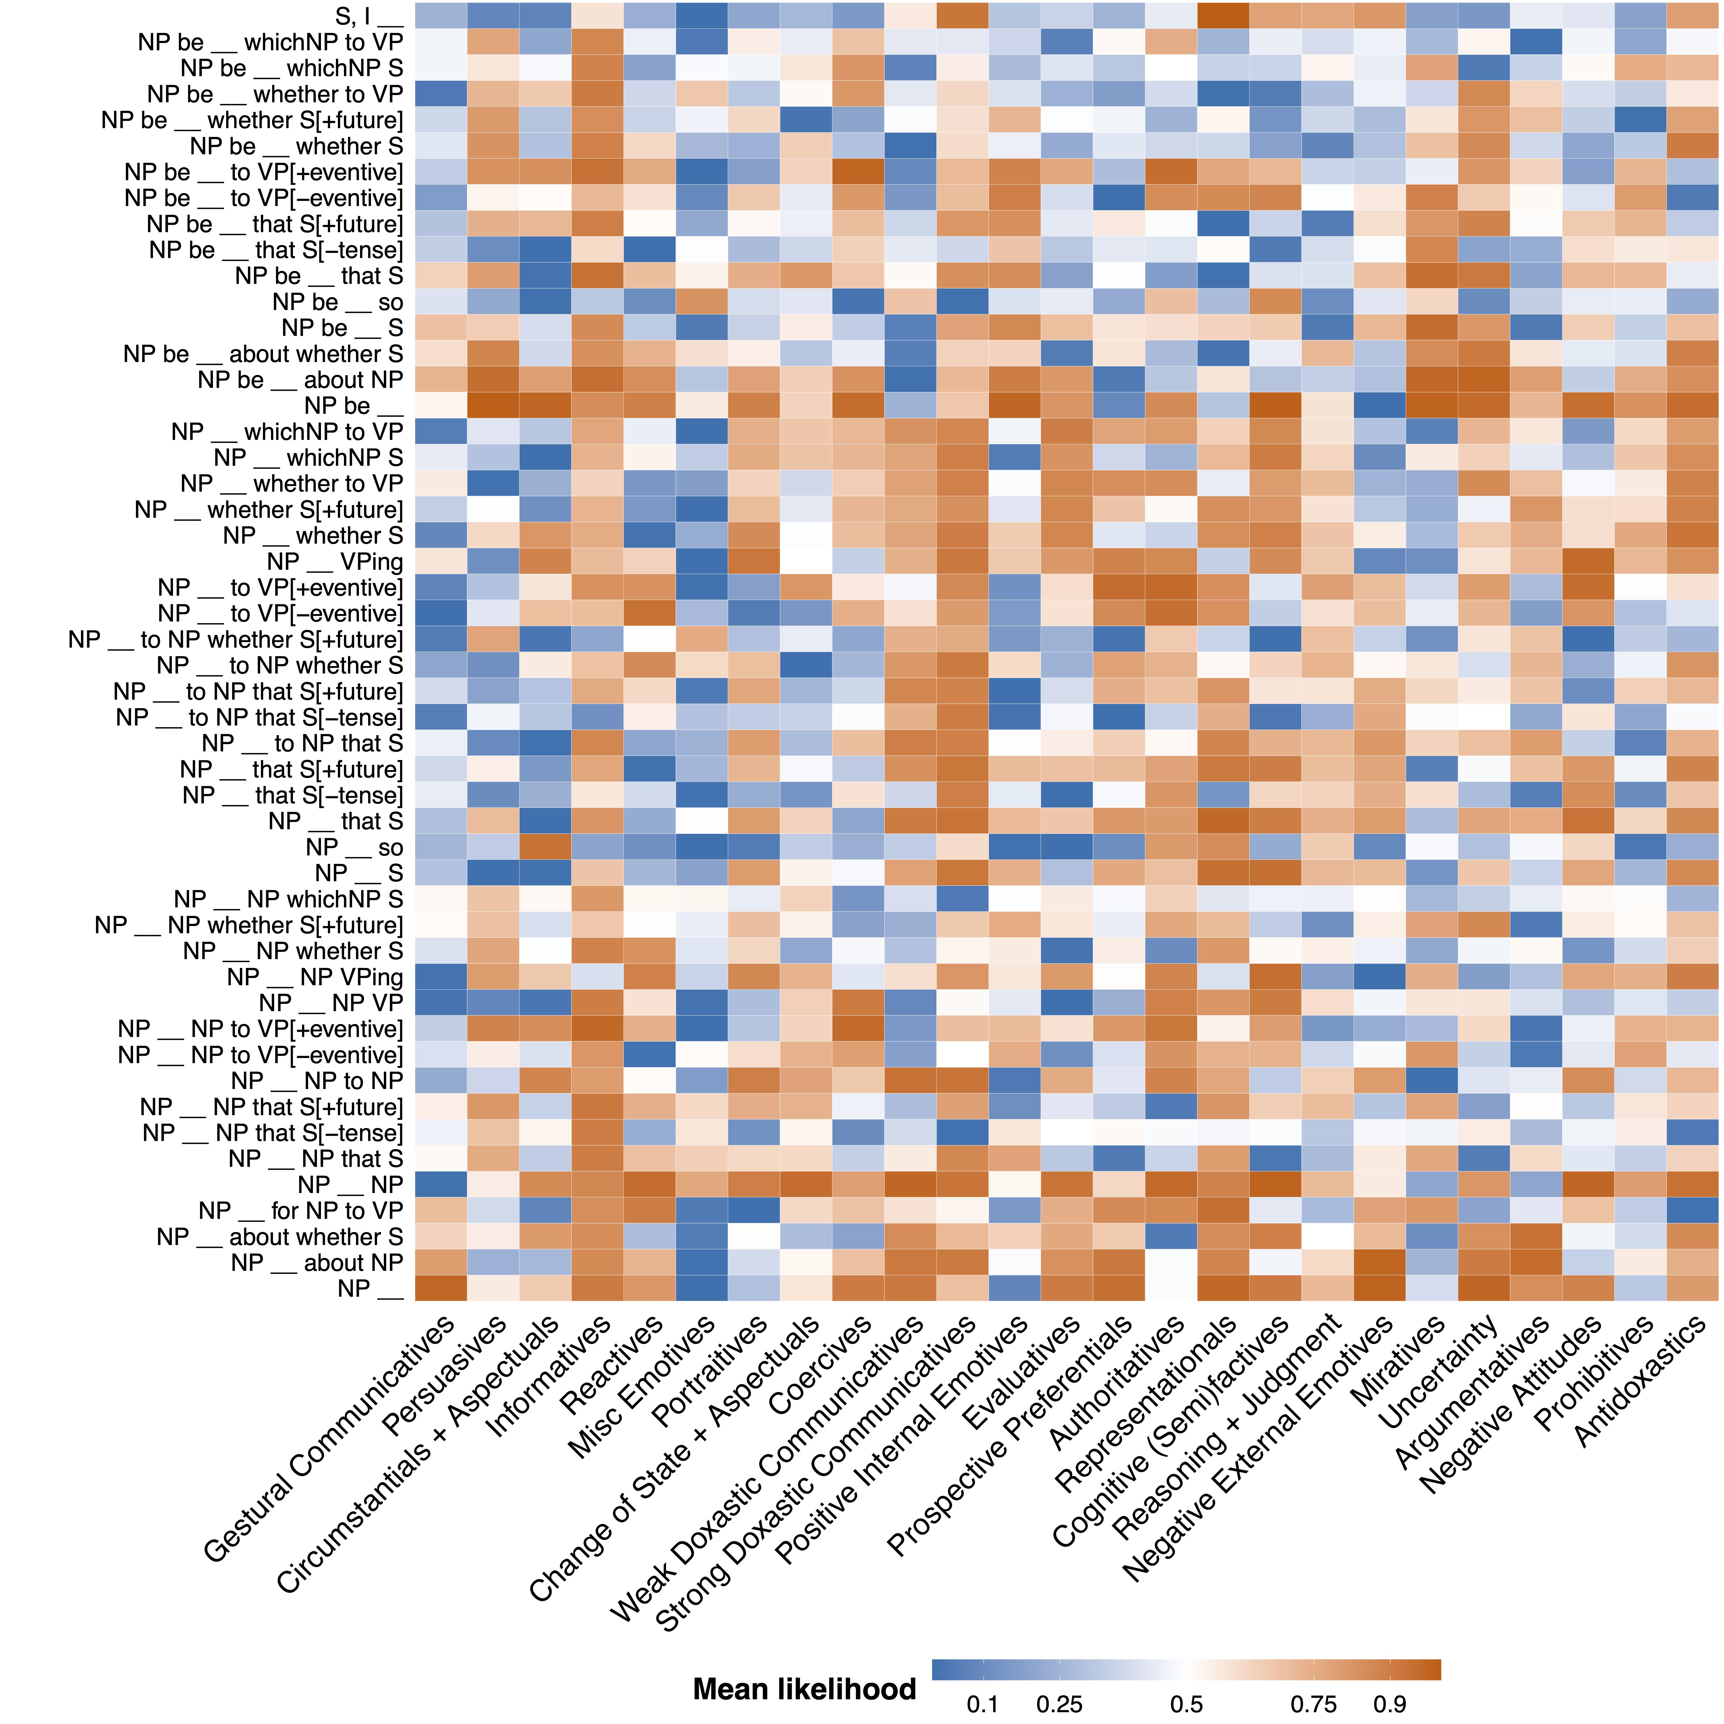
Simple present matrix

Slide 221
Past progressive matrix

Slide 222
Appendix H
Class-constituent relationship

Slide 223
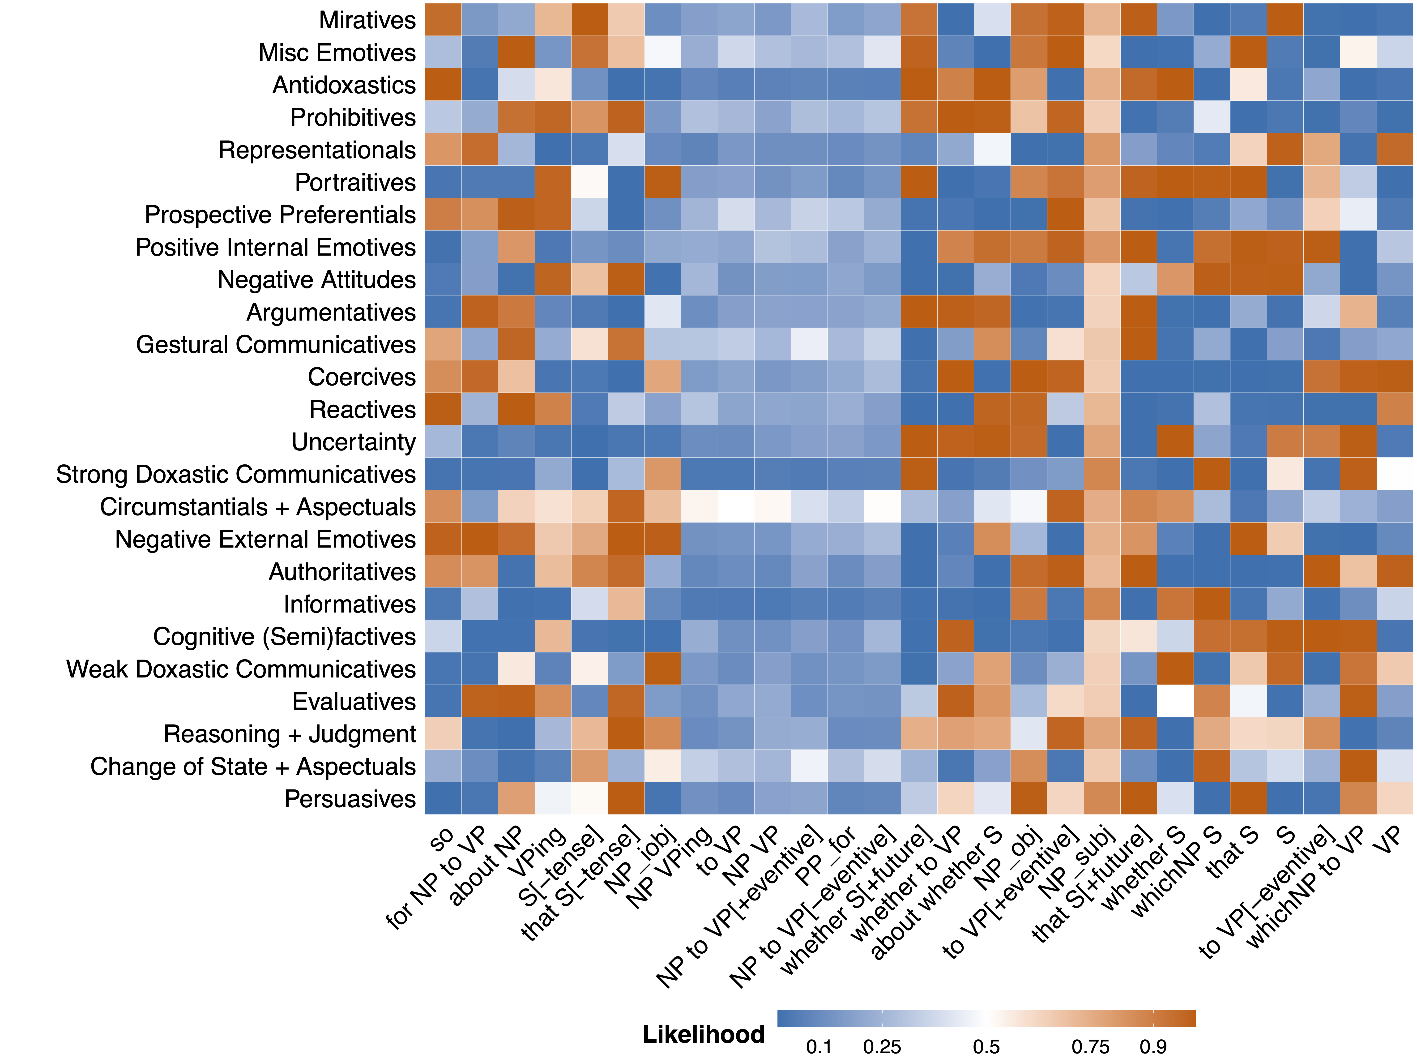

Slide 224
Appendix I
Class-inference relationships

Slide 230
Appendix J
Class-primitive relationships

Slide 232
Appendix K
Primitive-constituent relationships

